Slide 1
ANT 3120 Physiology – Exam 3

Slide 2
Cardiac Conduction System
Group of specialized , highly excitable cells that control heart rate
Spontaneously generates and conducts action potentials
Sinoatrial node ( SA node )
Atrioventricular node ( AV node )
AV bundle / Bundle of His
Purkinje fibers

Slide 3
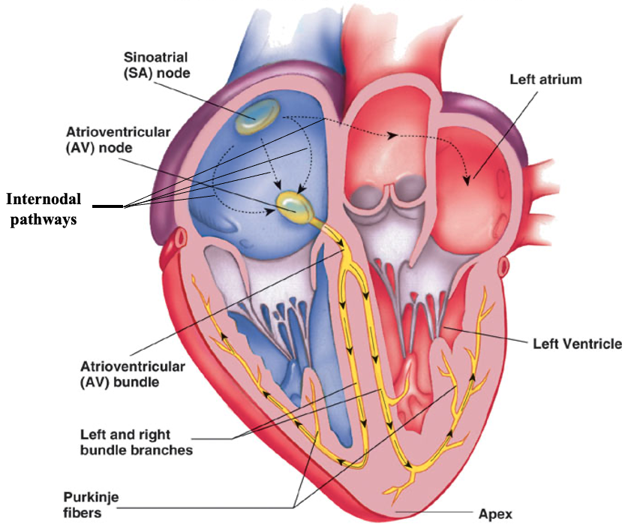

Slide 4
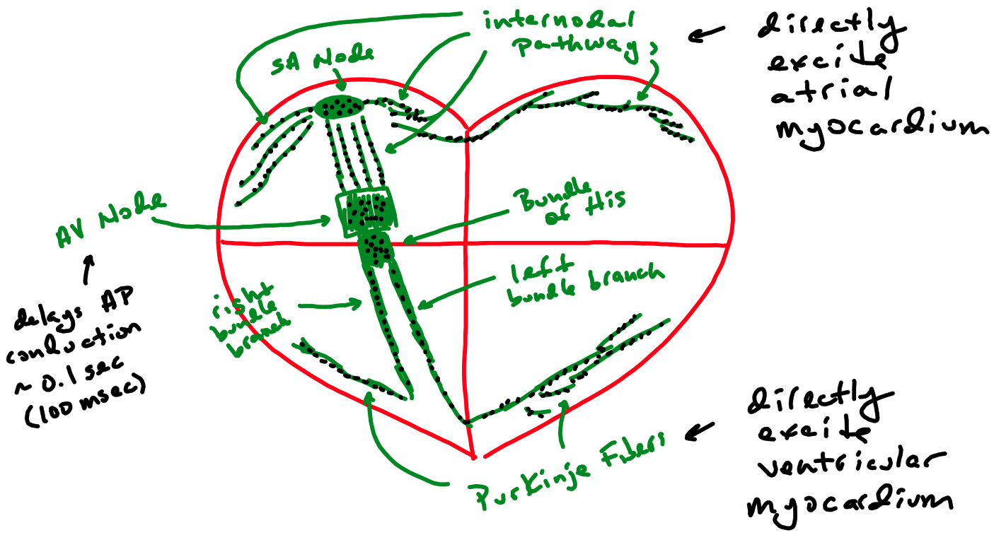

Slide 5
Cardiac Conduction System – Action Potential
Pacemaker potential initiated
Slow depolarization from resting V_{m} towards threshold
Via the opening of HCN channels and Ca²⁺ channels
HCN channels transport Na⁺ inward
Ca²⁺ channels transport Ca²⁺ inward
Fast depolarization occurs once threshold is reached
Opening of voltage-gated Ca²⁺ channels
Ca²⁺ transported inward
Fast repolarization
Opening of voltage-gated K⁺ channels causes fast repolarization
K⁺ transported outward
Action potentials conduct through the cardiac conduction system
These action potentials then elicit action potentials in cardiac muscle

Slide 6
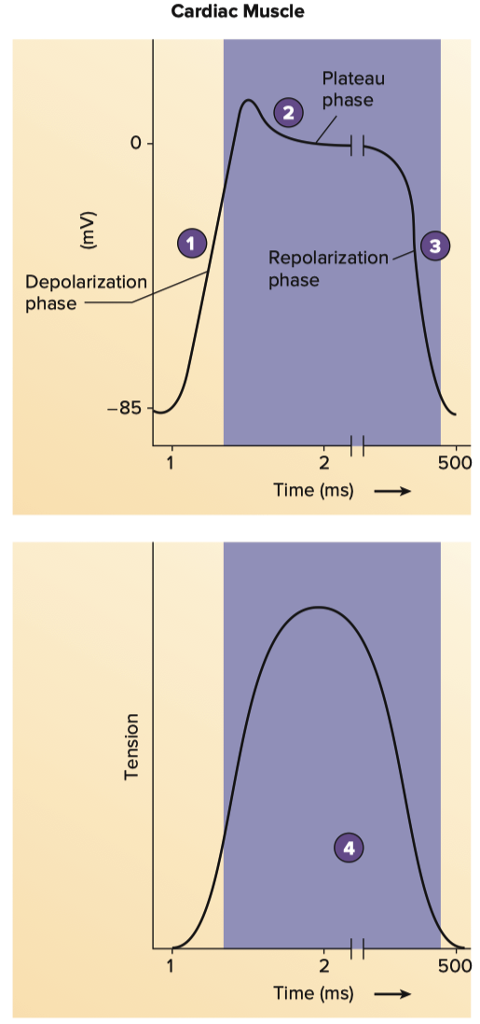
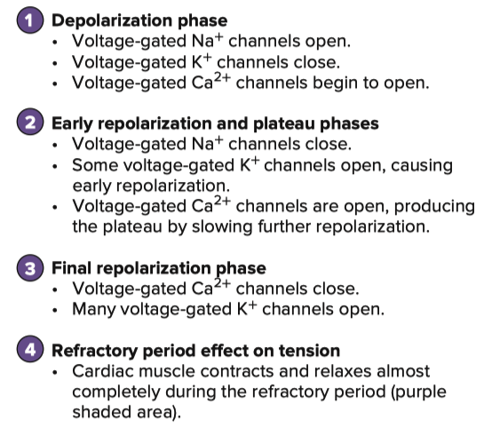

Slide 7
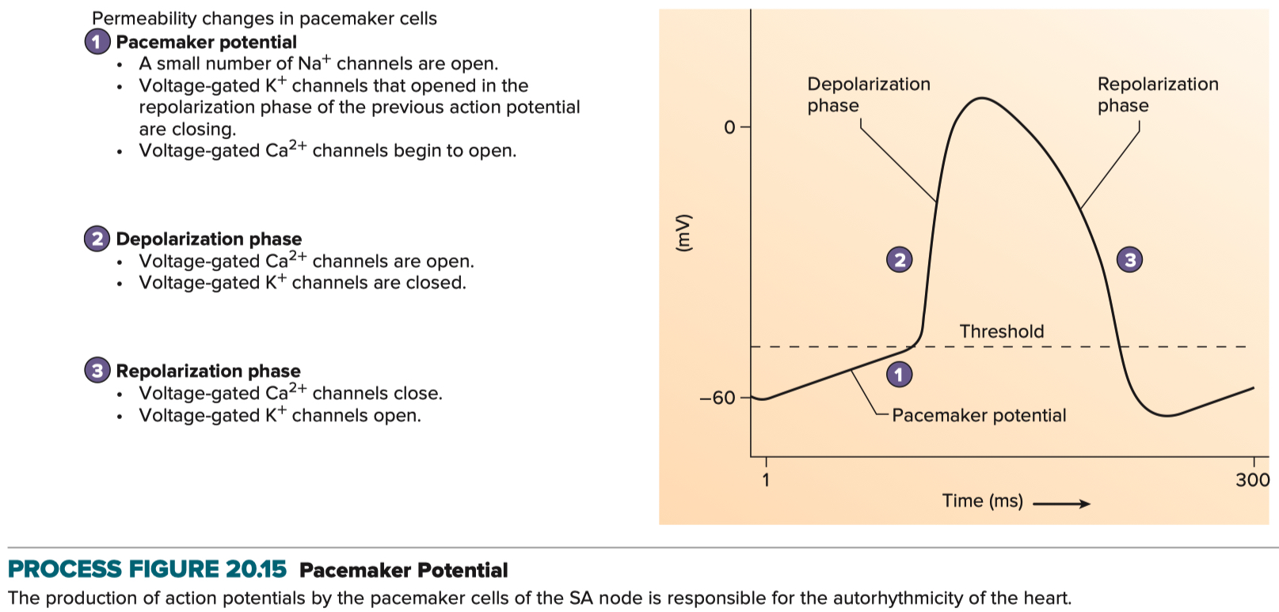

Slide 8
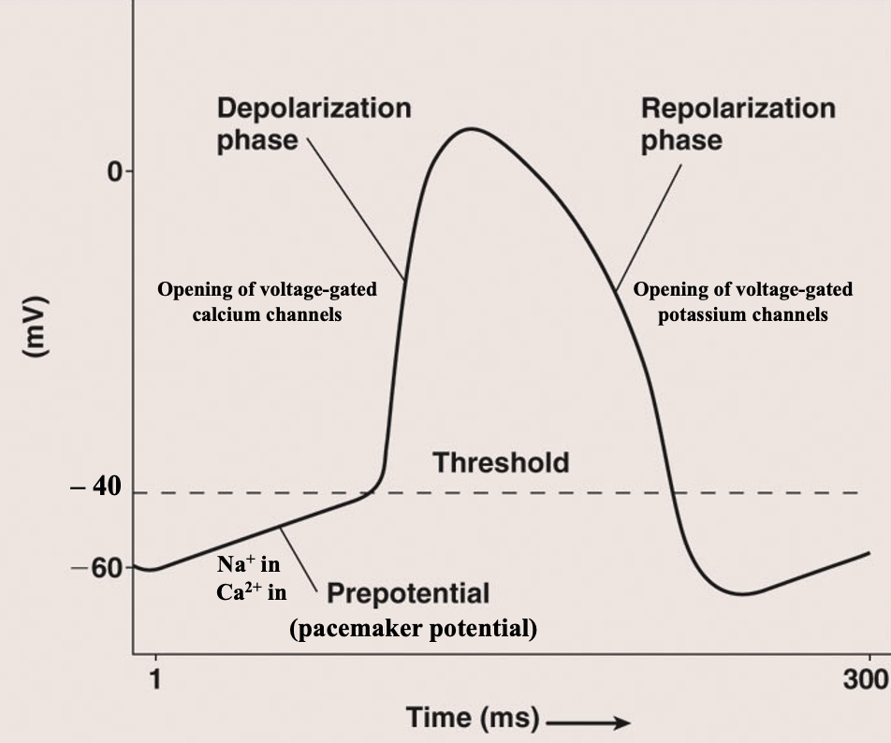

Slide 9
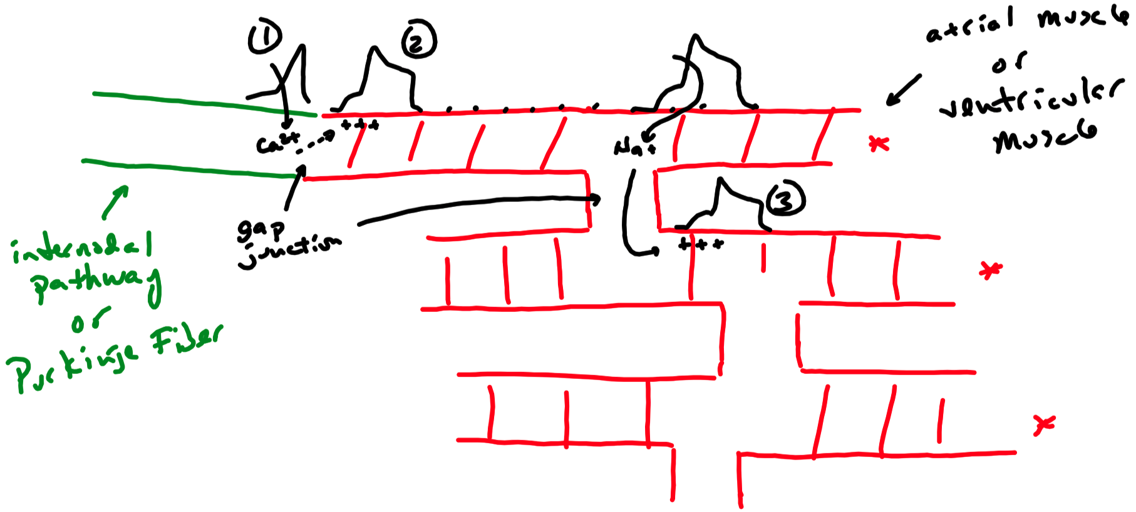

Slide 10
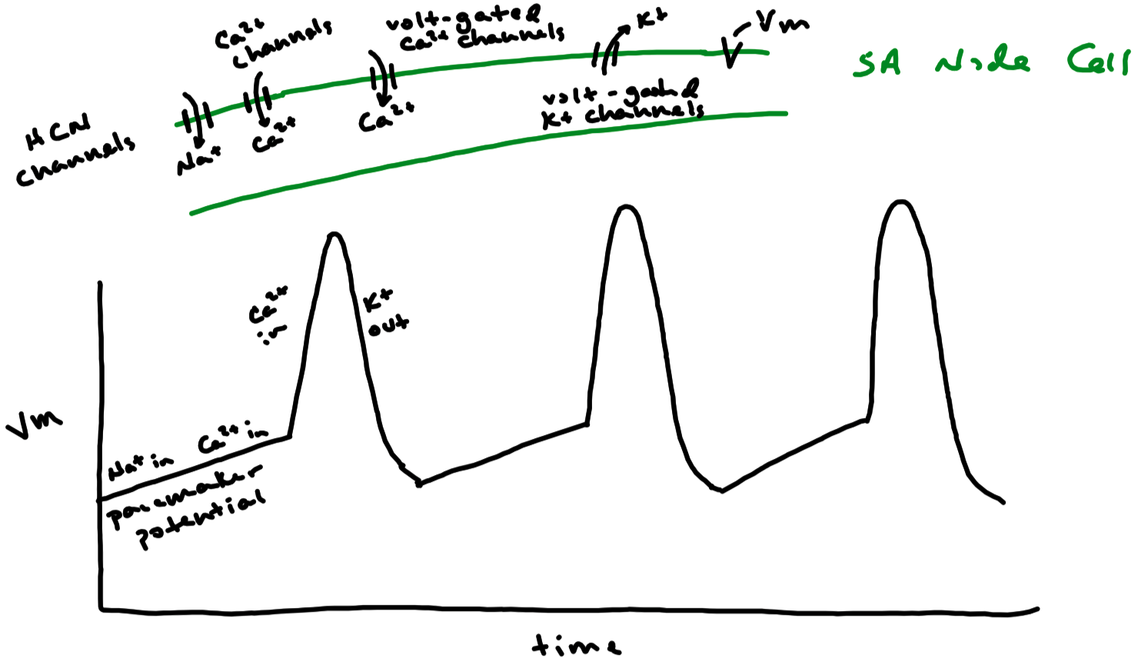

Slide 11
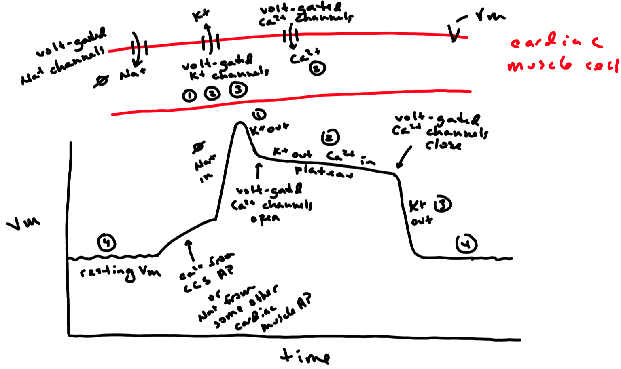

Slide 12
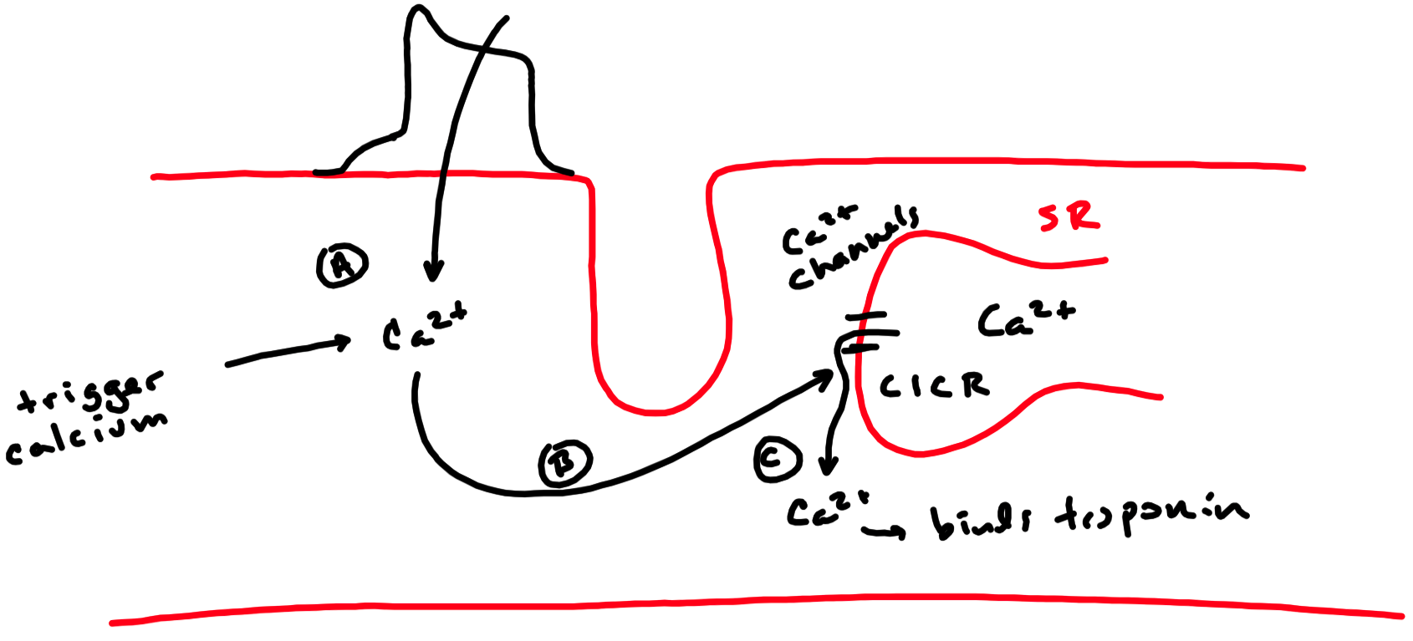
CICR = Calcium Induced Release

Slide 13
Cardiac Conduction System
Sinoatrial node ( SA node )
“Pacemaker” of the heart
Spontaneously generates action potentials at a rate of about 70 to 80 per minute
Conducts action potentials to the cardiac muscle of the atria via internodal pathways
Conducts action potentials to atrioventricular node via internodal pathways
Atrioventricular node ( AV node )
Receives action potentials from the SA node
Delays conduction of action potentials approximately 100 msec ( i.e. 0.1 seconds )
Prevents action potentials from spreading to Purkinje fibers too soon
Ultimately allows atria to fully contract before ventricles contract
Conducts action potentials to AV bundle / Bundle of His after the 100 msec delay
AV bundle / Bundle of His
Receives action potentials from the AV node
Conducts action potentials to the right and left bundle branches
Right bundle branch and Left bundle branch
Receive action potentials from the Bundle of His
Conduct action potentials to the Purkinje fibers
Purkinje fibers
Receive action potentials from the AV bundle / Bundle of His
Conduct action potentials to the cardiac muscle of the ventricles

Slide 14
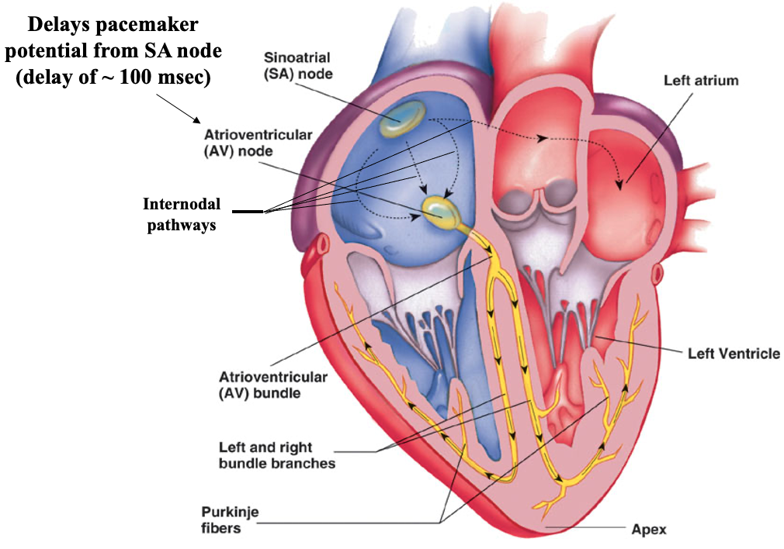

Slide 15
Ectopic Pacemaker
Ectopic Pacemaker = Any part of the heart other than the SA node that generates a rhythm
Most common ectopic pacemaker is AV node
Would slow heart rate to approximately 40 to 60 beats / min
Purkinje fibers could be an ectopic pacemaker
Would slow heart rate to approximately 25 to 45 beats / min
Ectopic pacemakers can either slow down or speed up heart rate

Slide 16
Cardiac Muscle Fiber / Cell
Cardiac muscle cells ( myocardium ) are arranged in a functional syncitium
Cardiac muscle makes a bulk of the atrial and ventricular walls

Slide 17
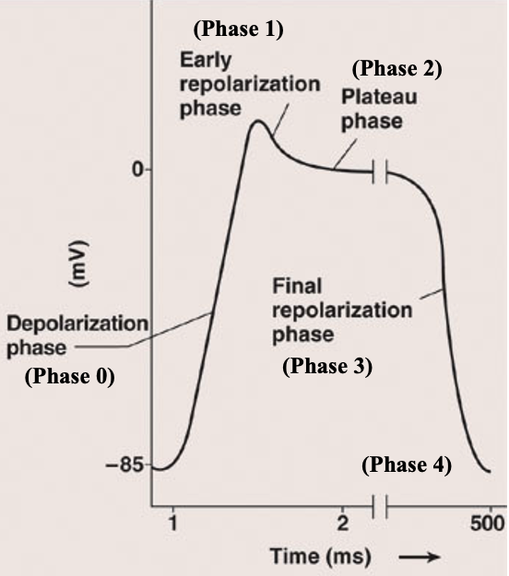
Cardiac Muscle Fiber / Cell – Action Potential
Phase 4 ( resting V_{m} )
Resting V_{m} established primarily via K⁺ channels
Phase 0 ( fast depolarization phase )
Occurs if threshold is reached
Threshold reached via:
Action potential from cardiac conduction system
Action potential from adjacent cardiac muscle cell
Voltage-gated Na⁺ channels open
Rapid transport of Na⁺ into the cell
Causes fast depolarization
Phase 1 ( early fast repolarization )
Voltage-gated K⁺ channels open with threshold
Rapid transport of K⁺ out of cell
Causes initial , fast repolarization
Phase 2 ( plateau phase )
Voltage-gated Ca²⁺ channels open
Rapid transport of Ca²⁺ into the cell
Voltage-gated K⁺ channels are still open at this time
Therefore , Ca²⁺ enters the cell while K⁺ exits the cell
However , transport of K⁺ predominates
Repolarization occurs slowly at this time
Phase 3 ( final fast repolarization phase )
Outward transport of K⁺ continues while voltage-gated Ca²⁺ channels close
Causes fast repolarization

Slide 18
Cardiac Muscle Fiber / Cell – Contraction
Action potential of cardiac muscle cell causes contraction of cardiac muscle cell
Excitation-Contraction Coupling
Sliding filament model ( thin filament slides over thick filament )
Calcium from phase 2 ( trigger calcium )
Causes calcium to be released from sarcoplasmic reticulum
Calcium-induced calcium release
Calcium binds to troponin
Initiates sliding filament model
Thin filament slides over thick filament
Causes shortening of sarcomere
Contraction stops when calcium is pumped back into the sarcoplasmic reticulum
Contraction of the atrial and ventricular myocardium
Allows ventricles to pump blood
Right ventricle pumps blood into the pulmonary trunk
Left ventricle pumps blood into the aorta

Slide 19
Electrocardiogram ( ECG ) / Elektrokardiogram ( EKG )
Recording of the electrical activity ( i.e. action potentials ) of cardiac muscle
Electrical activity can be recorded on the surface of the body
Amplitude of electrical activity is large , which is why it can be measured
Amplitude is large because the heart is a functional syncitium
NOT a recording of the action potentials of the cardiac conduction system
NOT a recording of mechanical activity
Recorded with an electrocardiograph

Slide 20
Electrocardiogram ( ECG ) / Elektrokardiogram ( EKG )
Recording of the electrical activity ( i.e. action potentials ) of cardiac muscle
Electrical activity can be recorded on the surface of the body
Amplitude of electrical activity is large , which is why it can be measured
Amplitude is large because the heart is a functional syncitium
NOT a recording of the action potentials of the cardiac conduction system
NOT a recording of mechanical activity
Recorded with an electrocardiograph

Slide 21
ECG – Leads
Standard bipolar limb leads
Measure the electrical activity of the heart in a frontal plane
Lead I: right arm ( – ) to left arm ( + )
Measures electrical activity across the heart at a 0° angle
Lead II: right arm ( – ) to left leg ( + )
Measures electrical activity across the heart at a +60° angle
Lead III: left arm ( – ) to left leg ( + )
Measures electrical activity across the heart at a +120° angle
Augmented unipolar limb leads
Measure the electrical activity of the heart in a frontal plane
aVR: right arm ( + ) to central terminal ground lead ( joining of left arm and left leg )
Measures electrical activity across the heart at a –150° angle
aVL: left arm ( + ) to central terminal ground lead ( joining of left leg and right arm )
Measures electrical activity across the heart at a –30° angle
aVF: left leg ( + ) to central terminal ground lead ( joining of right arm and left arm )
Measures electrical activity across the heart at a +90° angle
Chest leads / Precordial leads
Measure the electrical activity of the heart in a transverse plane
V1 , V2 , V3 , V4 , V5 , V6 leads arranged across the chest

Slide 22
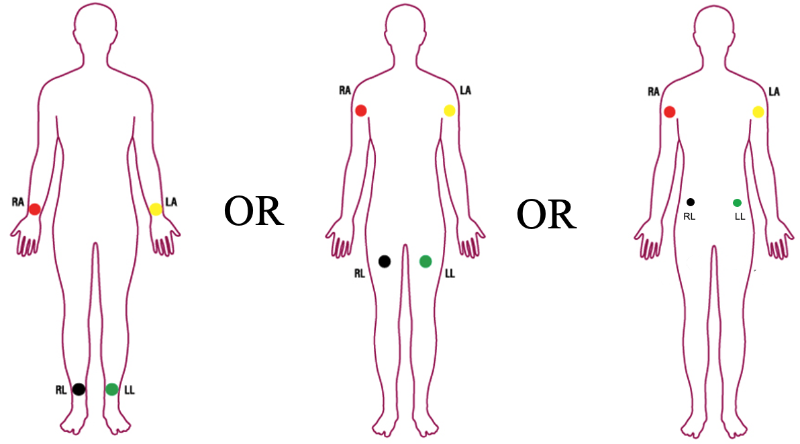
ECG – Limb Lead Electrode Placement

Slide 23
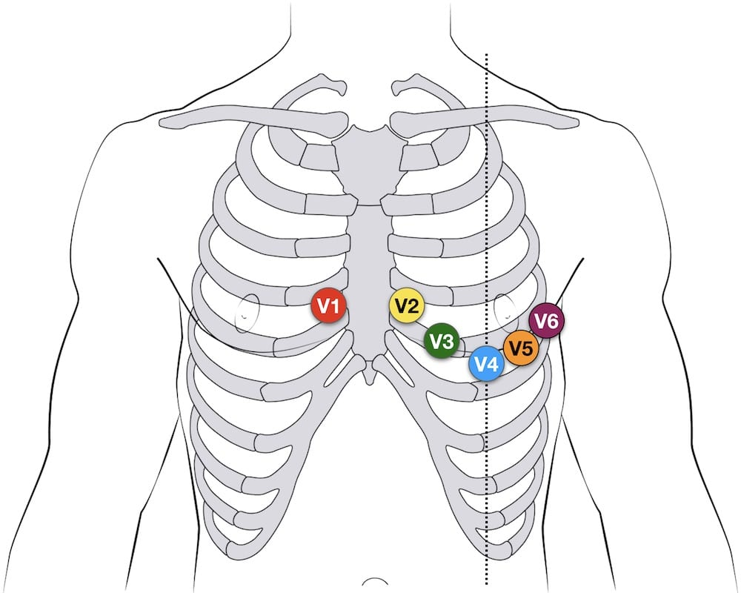
ECG – Chest / Precordial Lead Electrode Placement

Slide 24
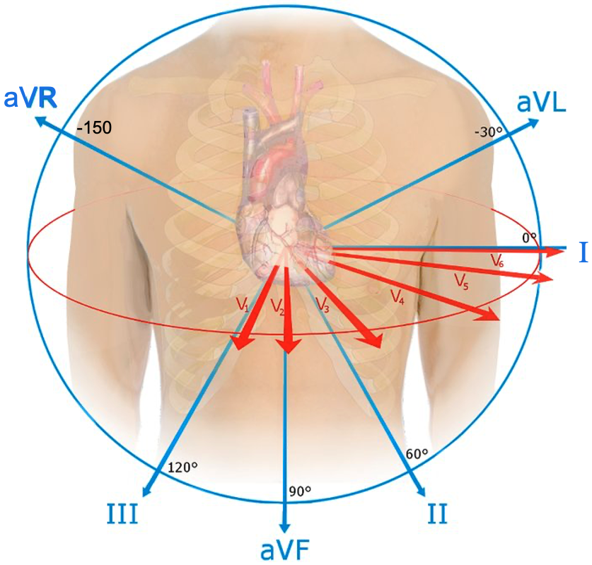
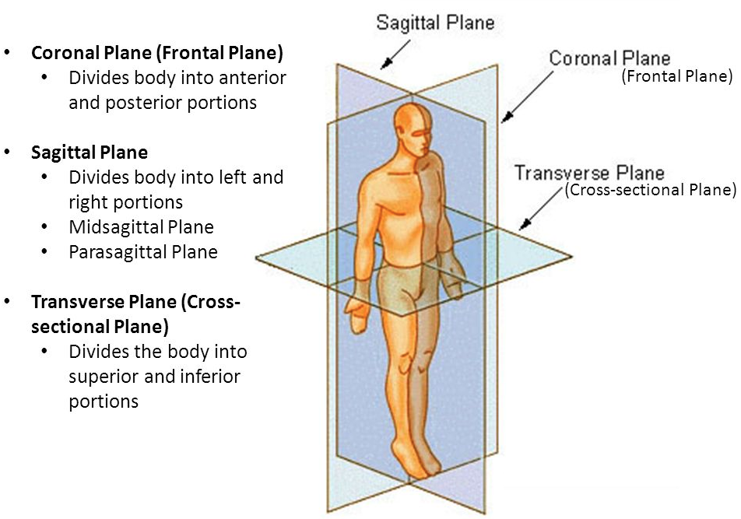
Limb Leads: measure the electrical activity of the heart in a frontal plane
Chest Leads: measure the electrical activity of the heart in a transverse plane

Slide 25
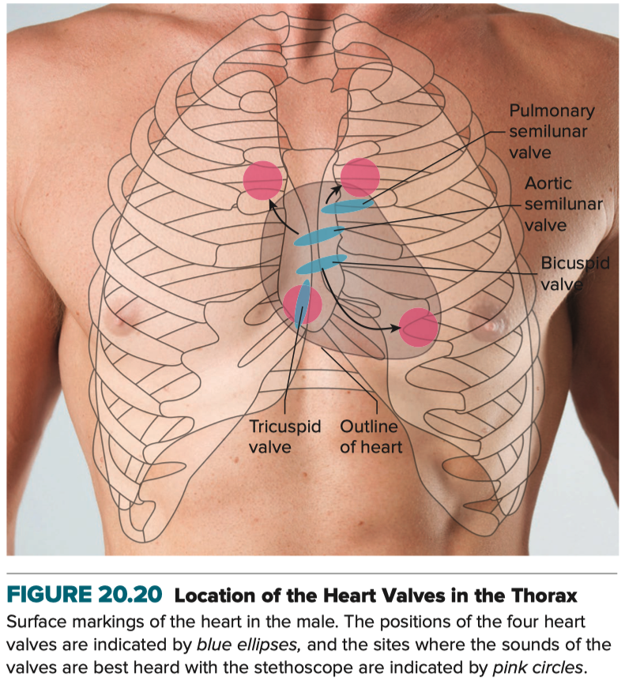

Slide 26
ECG – Trace
P wave
Measure of the depolarization of atrial muscle
Normally 80 to 120 msec in duration
QRS complex
Measure of the depolarization of ventricular muscle
Normally 60 to 100 msec in duration
T wave
Measure of the repolarization of ventricular muscle
Normally 160 to 200 msec in duration
PQ interval / PR interval
From the beginning of the P wave to the beginning of the Q wave
Time from onset of atrial depolarization to onset of ventricular depolarization
Time it takes action potentials to conduct through cardiac conduction system
Normally 120 to 200 msec in duration

Slide 27
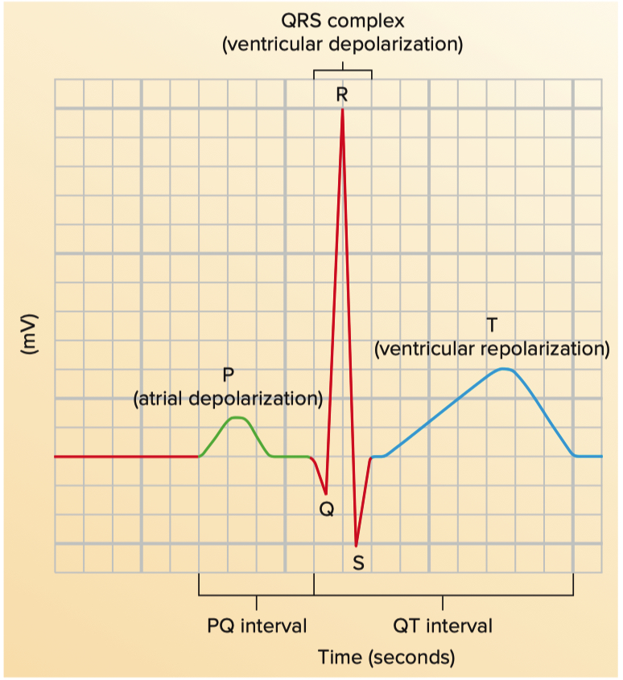
ECG – Trace

Slide 28
ECG – Trace
T = 160 to 200
P = 80 to 120
PQ = 120 to 200
QRS = 60 to 100
1 Box = 50 ms
1 Line = 250 ms

Slide 29
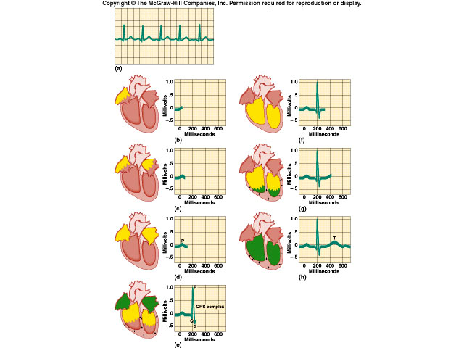

Slide 30
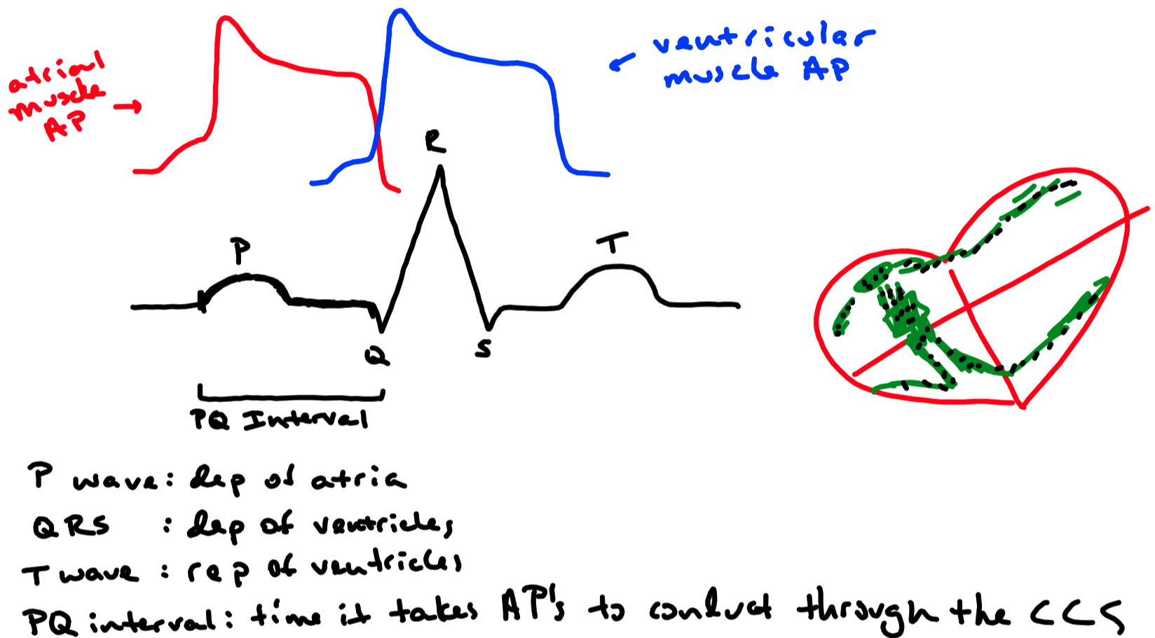

Slide 31
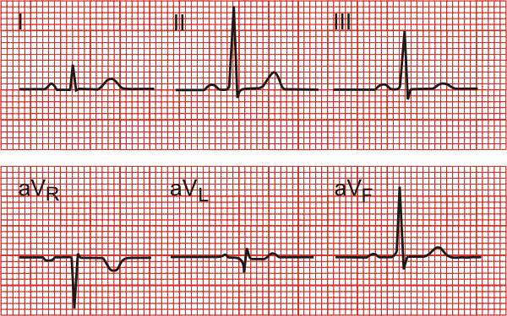
ECG – Trace of Limb Leads

Slide 32
ECG – 12 Lead Trace

Slide 33
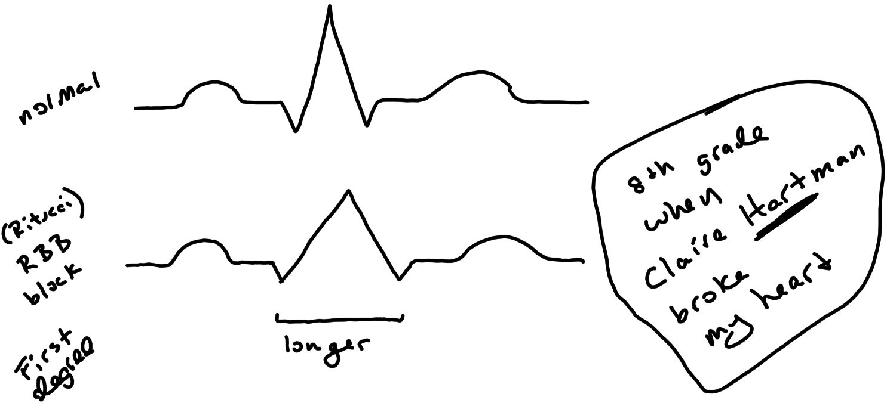
Arrhythmia / Dysrhythmia
Condition where the electrical activity is irregular

Slide 34
Tachycardia
Tachycardia – heart rate above 100 beats per minute
e.g . high sympathetic tone; hyperthyroidism , ectopic pacemaker
normal
tachycardia

Slide 35
Heart Block
Normal:
Conduction of action potentials is slowed
Not serious . . . needs no medical attention
First-Degree: Type I / Wenckebach
Conduction of action potentials is slowed more
Not too serious but dizziness can occur
Second-Degree: Type II / Mobitz
Conduction of action potentials is slowed more and blocked
Most will require an artificial pacemaker
Third-Degree:
Complete block of action potential conduction
No relationship between P wave and QRS complex
Most often due to heart disease or congenital
Artificial pacemaker will be required

Slide 36
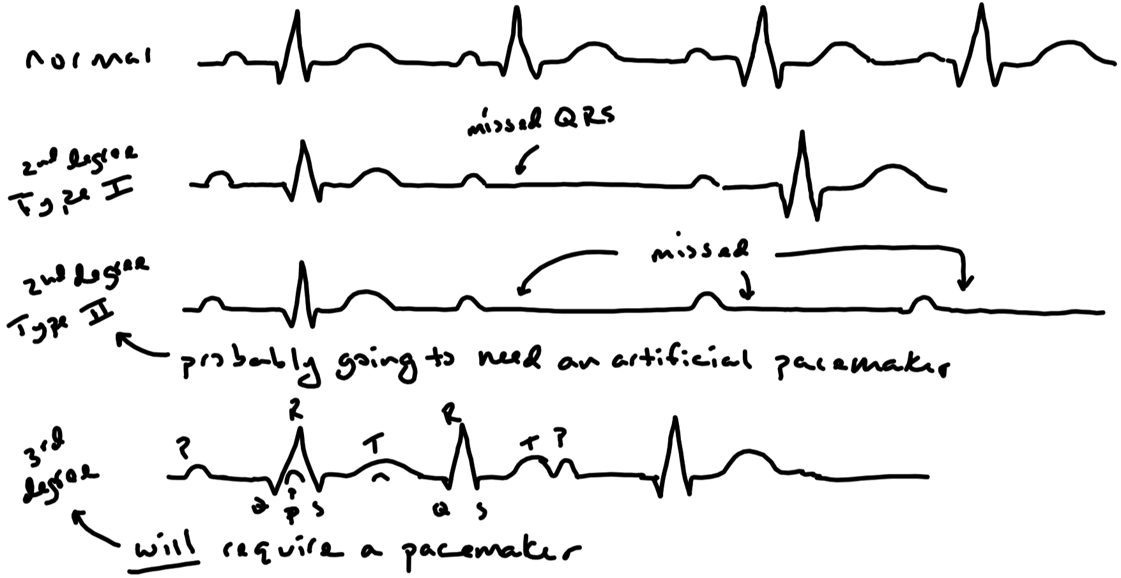

Slide 37
Atrial Fibrillation
Block of action potential in atria; AV node activated sporadically
No observable P waves and no constant QRS spacing
Atria do not fully contract
Certain percentage of blood fails to be delivered to the ventricles
Often presents with no symptoms
Reason: sufficient amount of blood is delivered to the ventricles
However , increases risk of blood clots due to stasis in atria

Slide 38
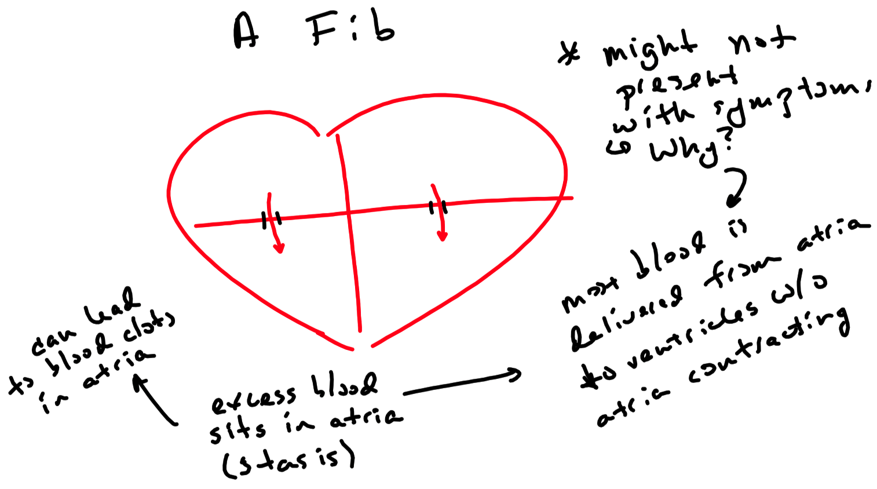

Slide 39
Opening and Closing of Heart Valves
Valves function to allow the flow of blood through the heart in only one direction
Blood from atria to ventricles
Blood from ventricles to great arteries
Opening and closing of valves is passive
Dictated by pressure changes in the chambers of the heart and great arteries
Atrioventricular ( AV ) valves ( tricuspid valve and mitral valve )
Open when atrial pressure exceeds ventricular pressure
Close when ventricular pressure exceeds atrial pressure
Semilunar valves ( pulmonary valve and aortic valve )
Open when ventricular pressure exceeds pulmonary trunk and aortic pressure
Close when pulmonary trunk and aortic pressures exceed ventricular pressure
Closing of valves and the collision of blood against them produce heart sounds
First heart sound ( “lub” ) – S₁
Closing of AV valves
Second heart sound ( “dub” ) – S₂
Closing of pulmonary and aortic semilunar valves

Slide 40
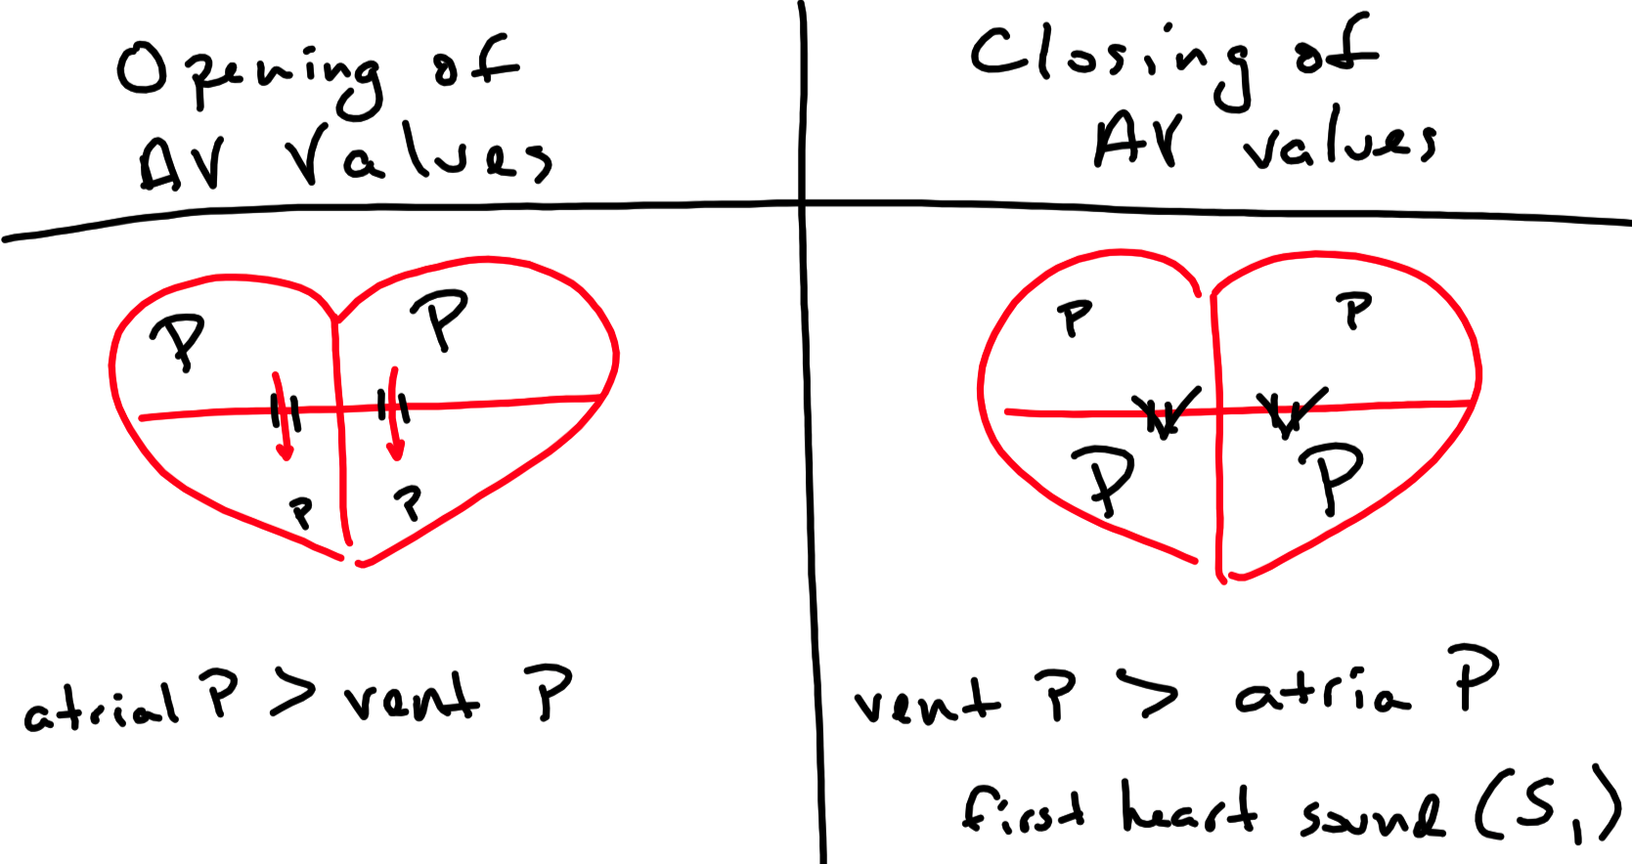

Slide 41
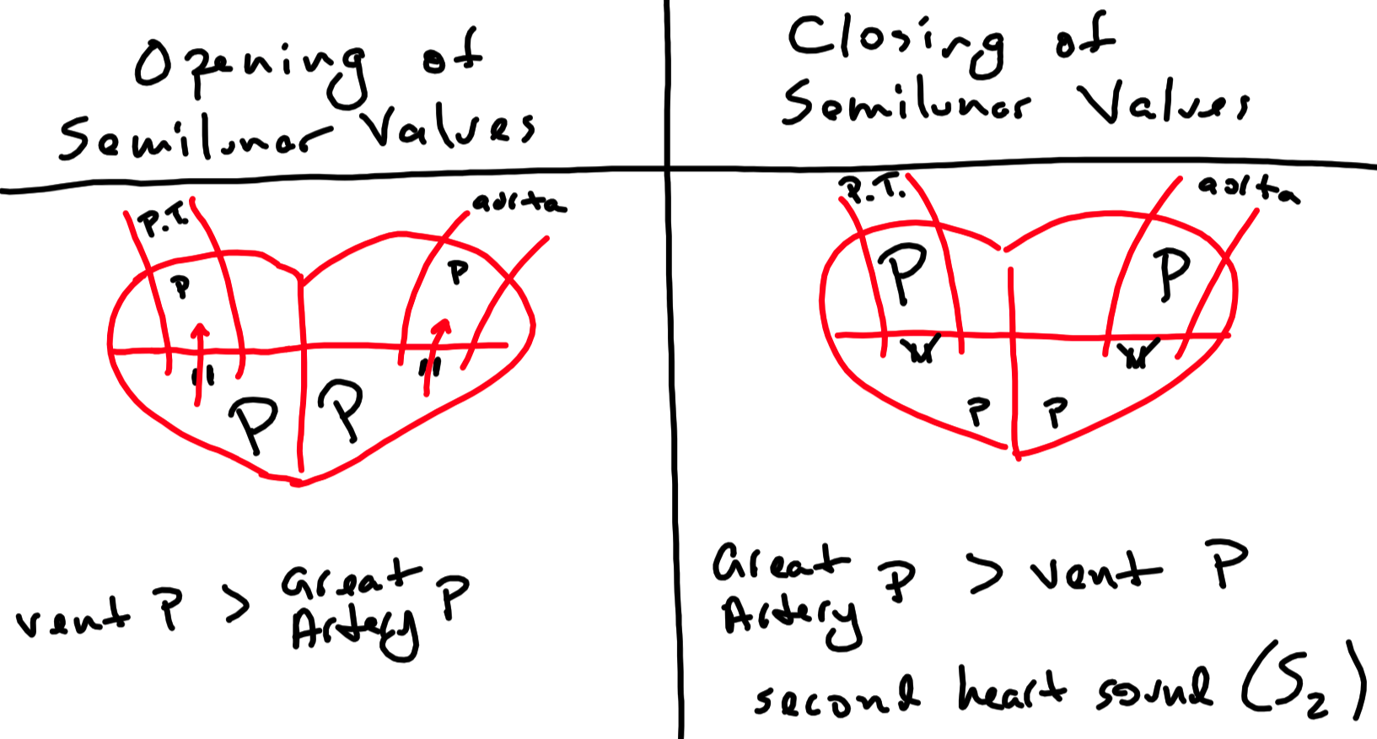

Slide 42
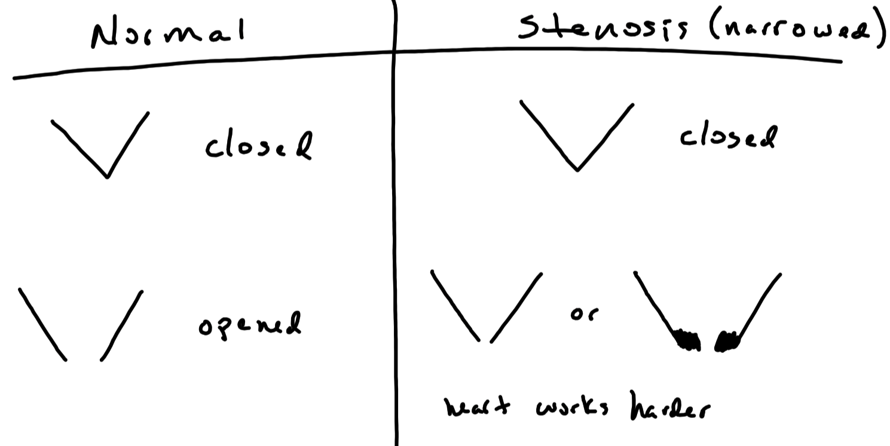

Slide 43
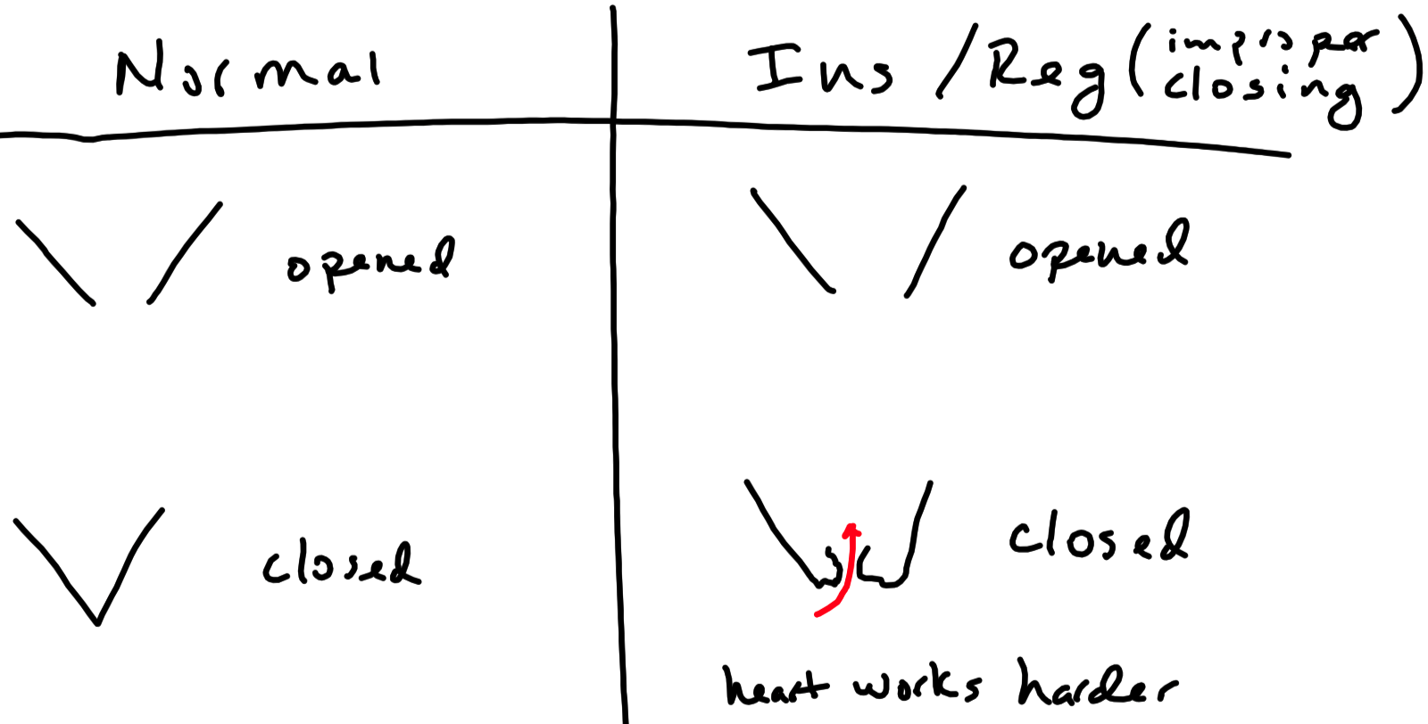

Slide 44
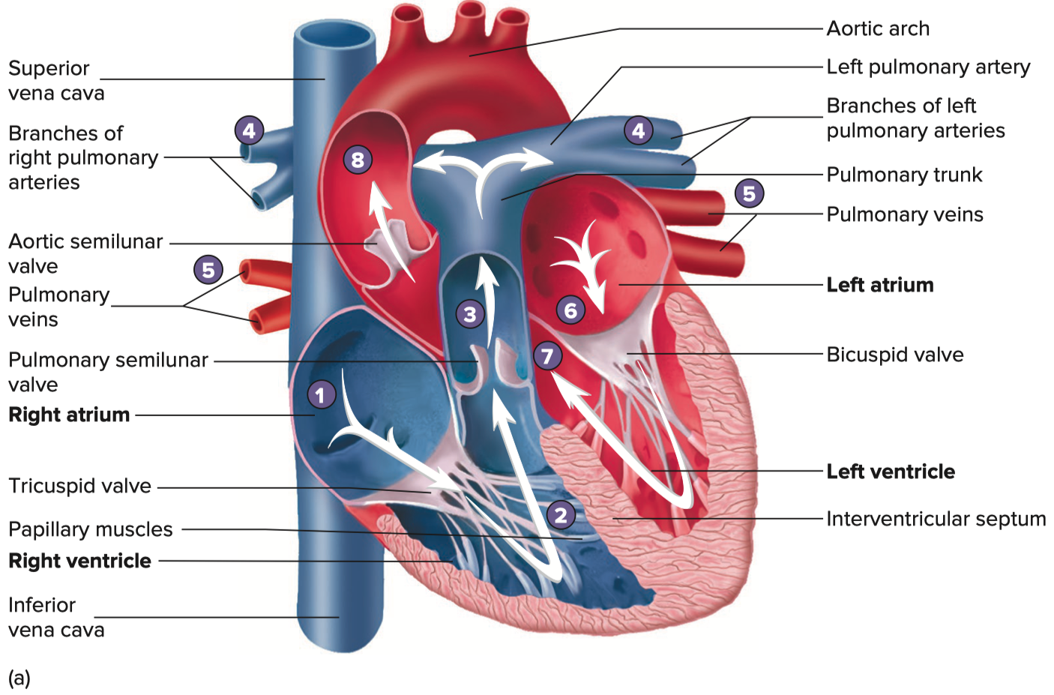

Slide 45
Heart Murmurs
Indicates turbulent blood flow
Septal defects ( hole in the septum ) and increased blood flow through the heart
Valve disorders
Stenosis
Narrowing of valves
Creates resistance to flow
Murmur heard when blood flows through valve
Insufficiency / Regurgitation
Improper closing of valves
Back flow of blood through valve
Murmur heard when valves close
Aortic valve disorders are the most common
Systolic murmur ( between S₁ and S₂ )
AV regurgitation
Semilunar stenosis
Diastolic murmur ( between S₂ and S₁ )
Semilunar regurgitation
AV stenosis

Slide 46
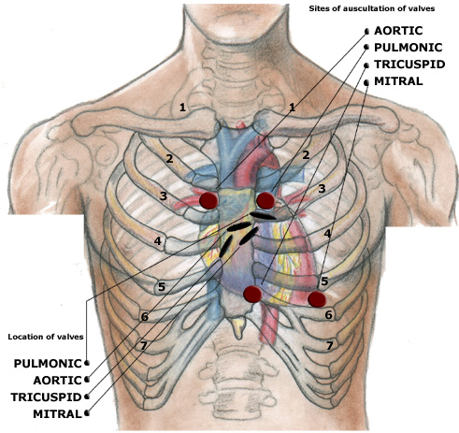
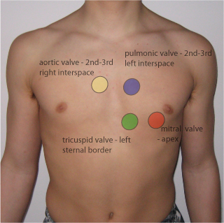
Auscultations of the Heart
Second intercostal space
Left side slightly away from midline: pulmonary semilunar valve
Right side slightly away from midline: aortic semilunar valve
Fifth intercostal space
Left side slightly away from midline: tricuspid valve
Left side close to the nipple line: mitral valve

Slide 47
Cardiac Cycle
Events that make up one heart beat
Systole
Heart spends approximately ⅓ of its time in systole
Atrial systole
Time the atria are contracting
Ventricular systole
Time the ventricles are contracting
If systole is used without specifying a chamber , ventricular systole is implied
Diastole
Heart spends approximately ⅔ of its time in diastole
Atrial diastole
Time the atria are relaxing
Ventricular diastole
Time the ventricles are relaxing
If diastole is used without specifying a chamber , ventricular diastole is implied
Divided into five periods
Isovolumic contraction
Period of ejection
Isovolumic relaxation
Passive ventricular filling
Active ventricular filling

Slide 48
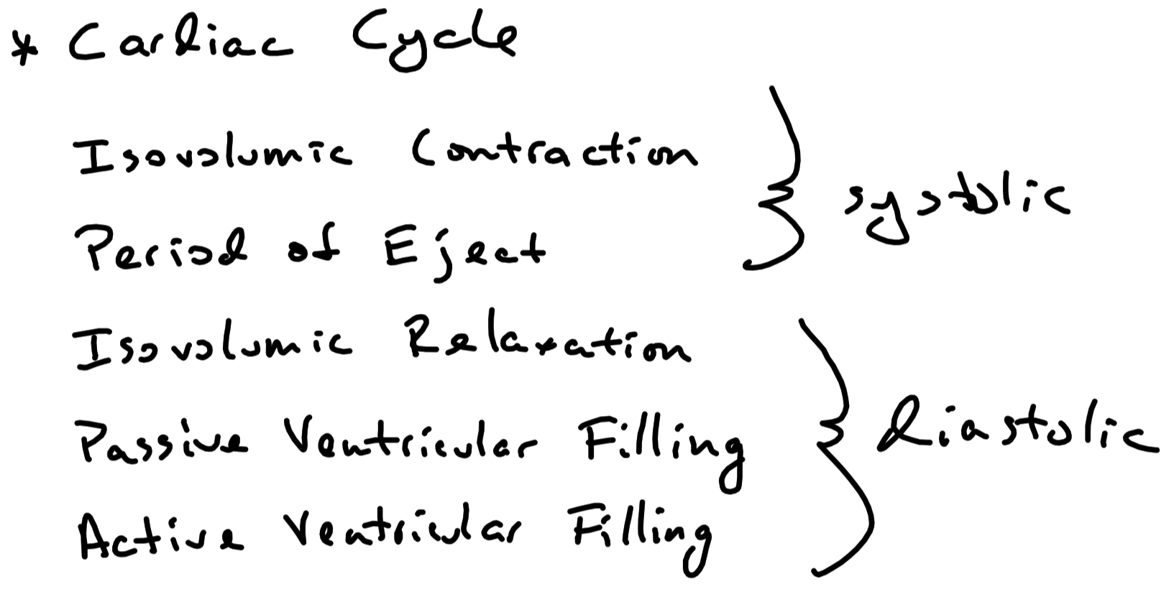

Slide 49
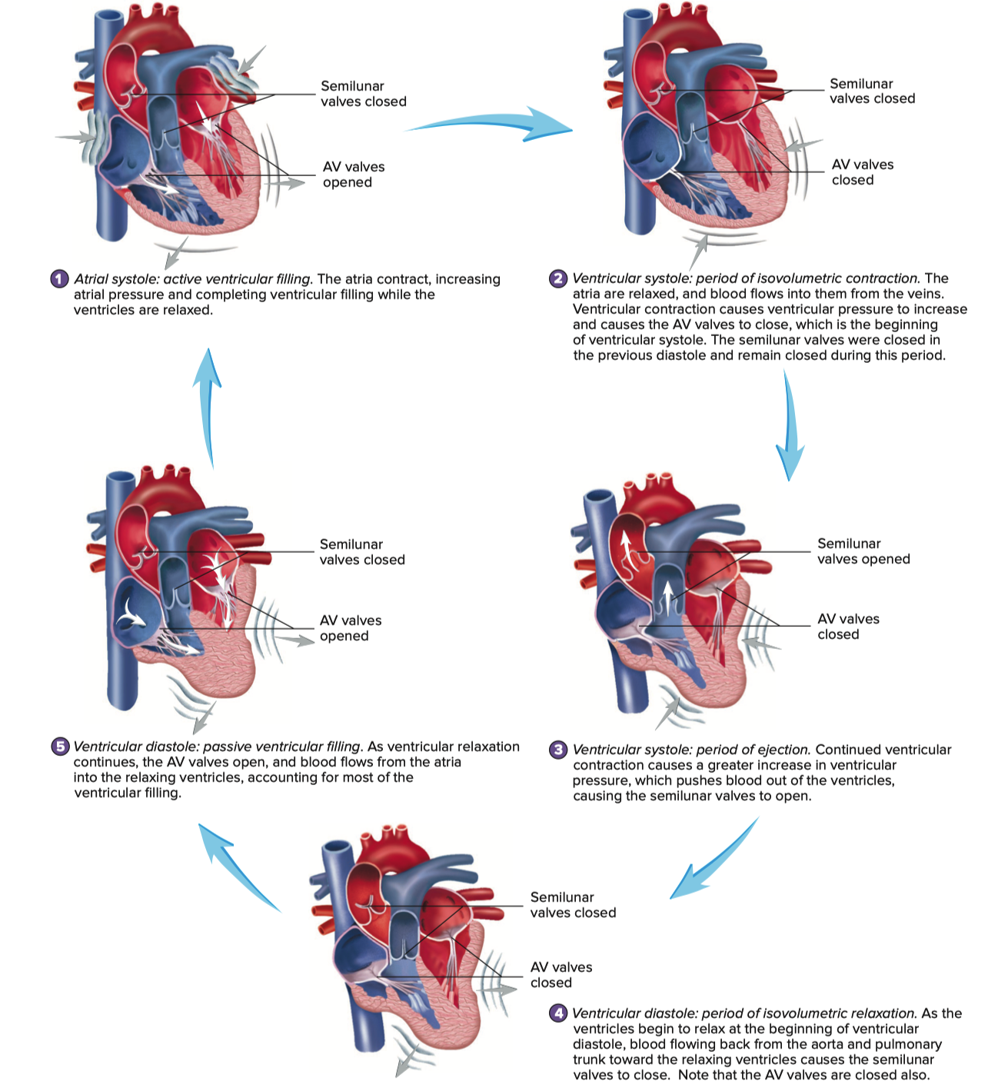
Systole
isovolumic contraction
passive ventricular filling
Diastole
active ventricular filling
period of ejection
isovolumic relaxation

Slide 50
Cardiac Cycle – Systole – Isovolumic Contraction
Isovolumic contraction ( part of systole )
Ventricles begin to contract
Ventricular pressure increases and eventually exceeds atrial pressure
AV valves snap shut (all heart valves are now closed)
Therefore, no blood flow into or out of ventricles
Ventricular blood volume does not change
First heart sound ( S₁ )
AV insufficiency first heard at this time

Slide 51
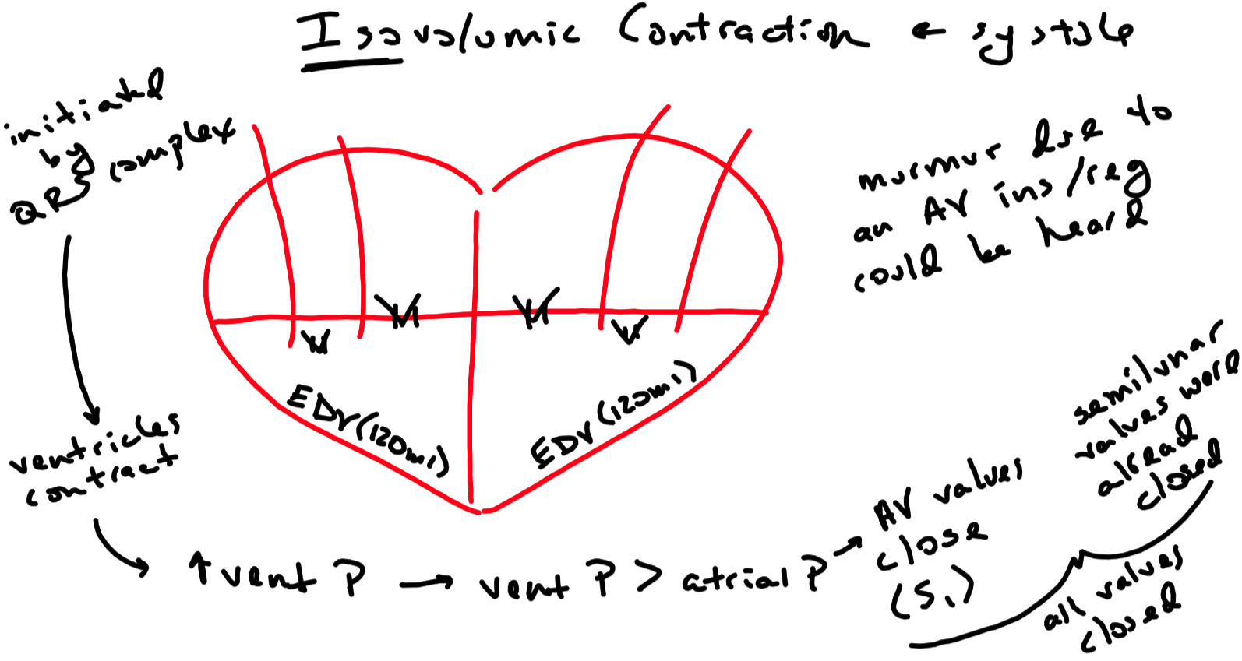
End-diastolic volume

Slide 52
Cardiac Cycle – Systole – Period of Ejection
S₁ is still evident at the onset of ejection
Ventricular pressure increases further and exceeds pressure of great arteries
Forces aortic and pulmonary semilunar valves to open
Blood ejected from ventricles into pulmonary trunk and aorta
Approximately same volume of blood ejected to each
This despite the great difference in pressure
Stroke volume ( SV )
Volume of blood ejected to each great artery ( ~ 70 ml )
End-diastolic volume ( EDV )
Volume of blood in ventricles prior to ejection of blood ( ~ 120 ml )
Ejection fraction ( EF )
Percentage of blood ejected from each ventricle ( 55 to 70% is normal )
EF = ( SV ) / ( EDV ) x 100
End-systolic volume ( ESV )
Volume of blood in the ventricles after the stroke volume is ejected
ESV = ( EDV ) – ( SV )
Semilunar stenosis first heard at this time

Slide 53
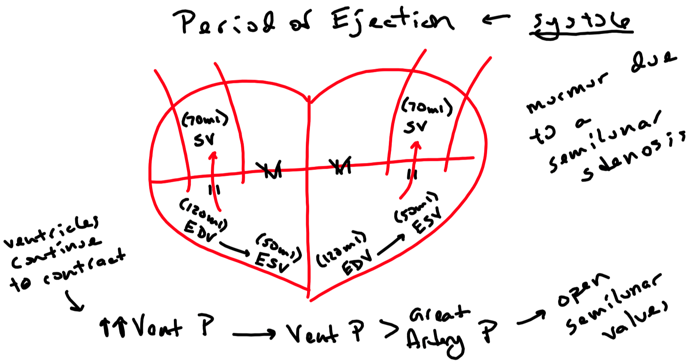

Slide 54
Cardiac Cycle – Diastole
Isovolumic relaxation ( part of diastole )
Relaxation of ventricles
Ventricular pressure decreases below pressure of great arteries
Semilunar valves snap shut ( all heart valves are now closed )
Ventricular blood volume does not change
Second heart sound ( S2 )
Semilunar insufficiency first heard at this time
Passive ventricular filling ( part of diastole )
Ventricular pressure decreases further and is now lower than atrial pressure
Forces AV valves to open
Blood flows passively from atria into ventricles
AV stenosis first heard at this time
Active ventricular filling ( part of diastole )
Atria contract and actively fill ventricles with more blood
End-diastolic volume ( EDV )
Volume of blood in ventricles when filled ( ~ 120 ml )

Slide 55
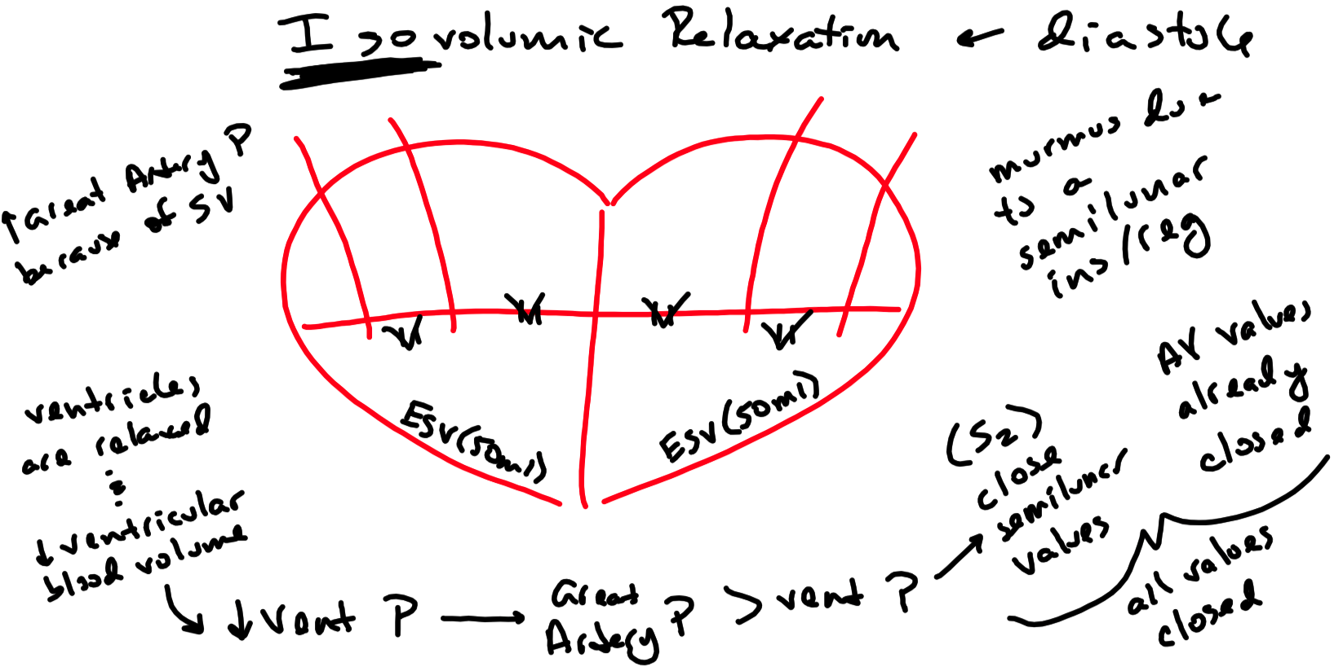

Slide 56
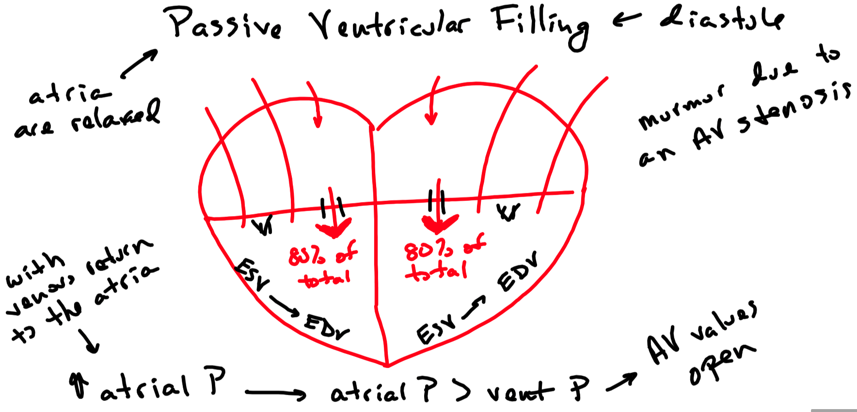

Slide 57
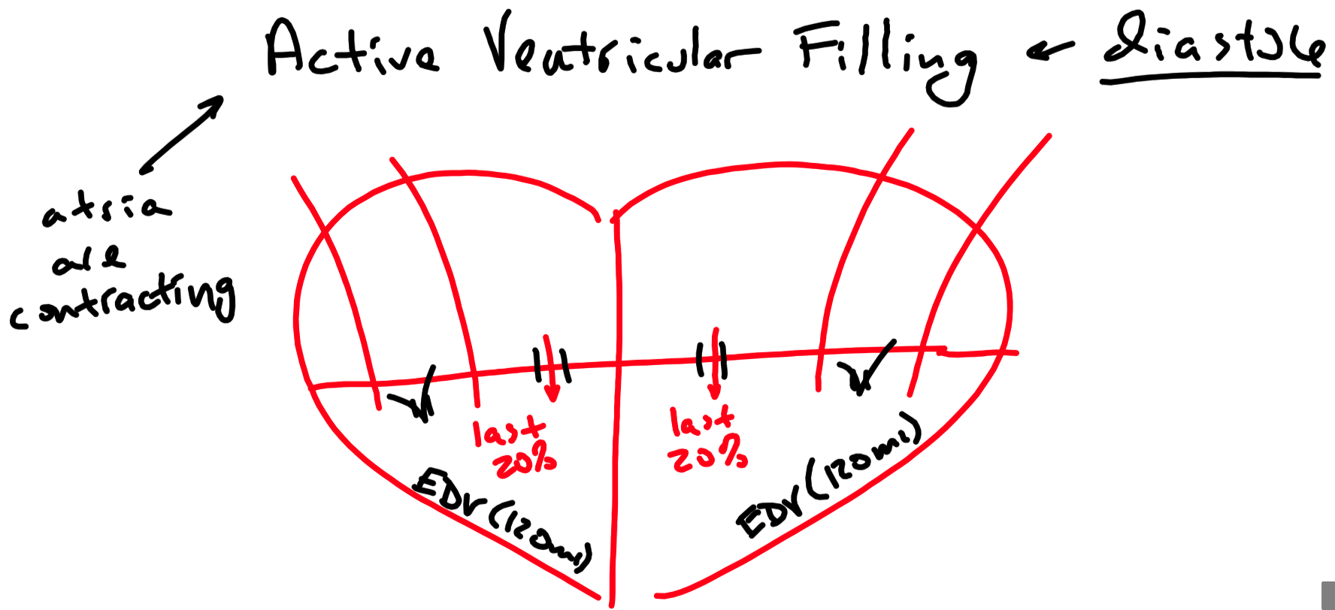

Slide 58
Cardiac Output ( CO )
Volume of blood pumped by either the left or right ventricle per minute
CO = ( SV ) x ( HR )
= ( 70 ml blood / heart beat ) x ( 70 heart beats / minute )
= 4,900 ml blood / minute or 4.9 liters blood / minute
Heart is most efficient when heart rate is low and stroke volume is high
Inotropic – something that affects heart contractility and therefore stroke volume
Chronotropic – something that affects heart rate

Slide 59
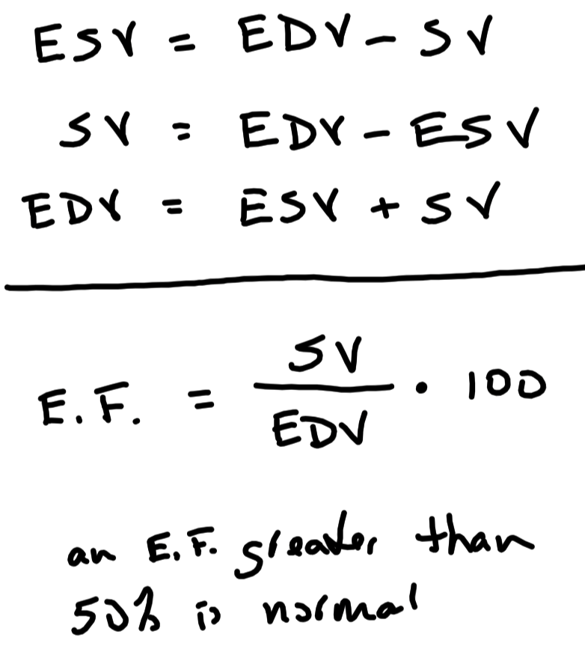

Slide 61
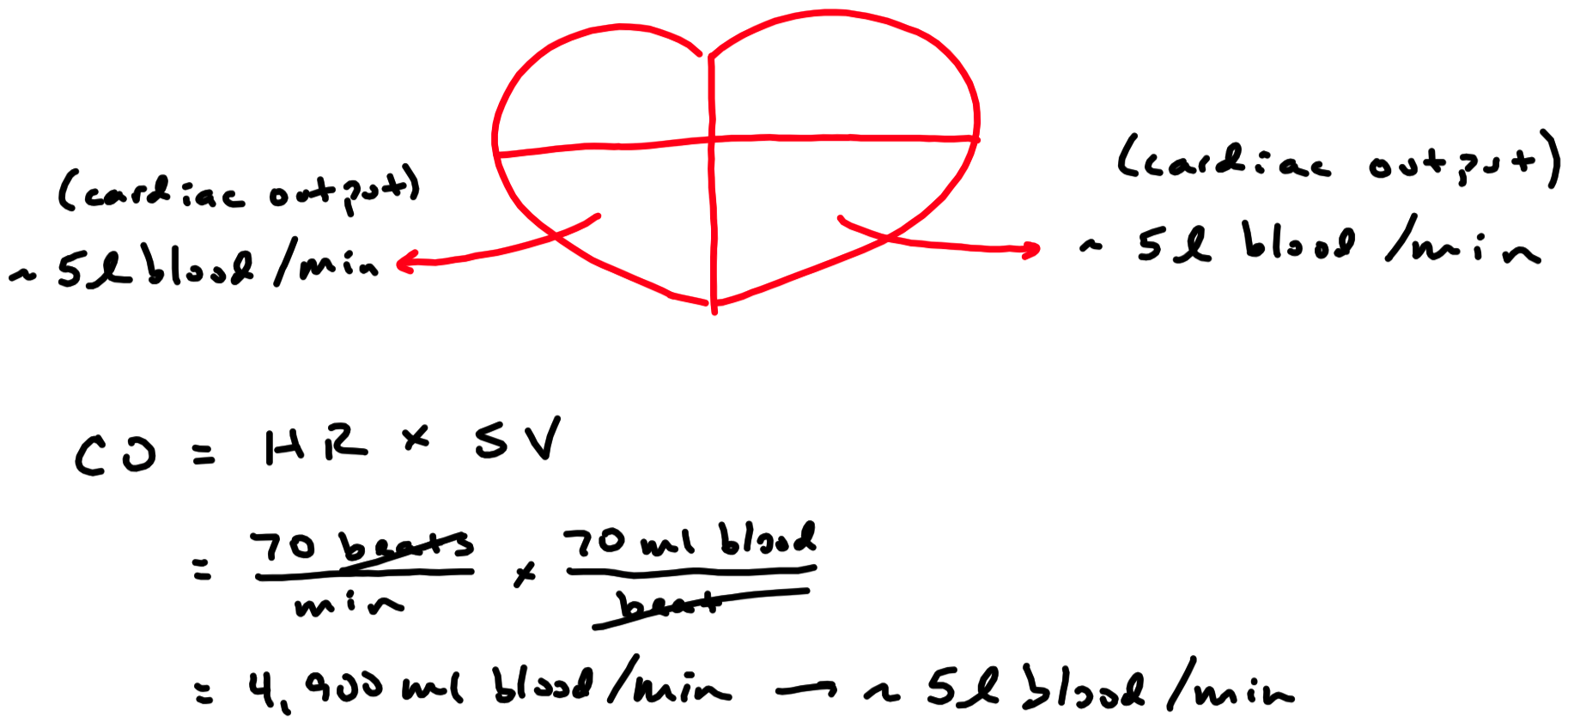

Slide 62
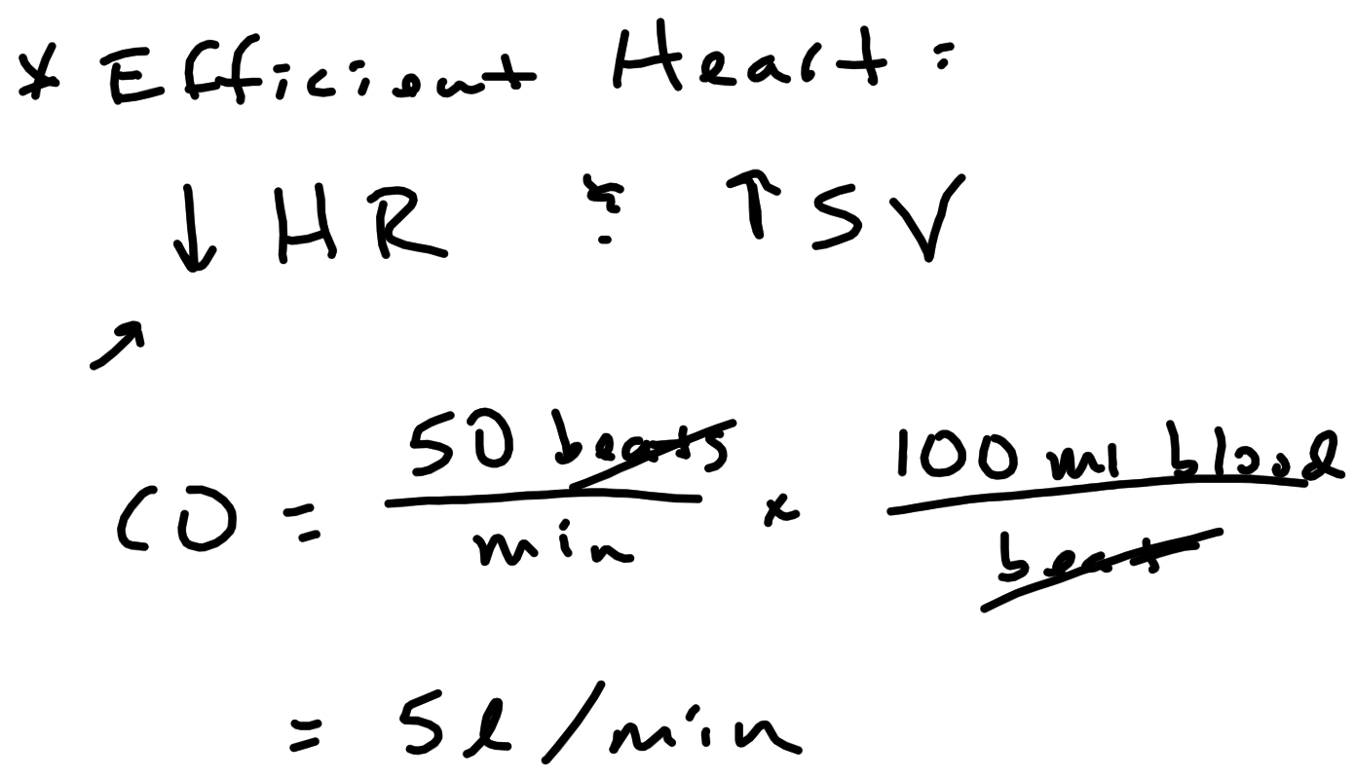

Slide 63
Regulation of Cardiac Output
Intrinsic Regulation
Extrinsic Regulation

Slide 64
Intrinsic Factors
Health of the myocardium
Healthy: normal contractility
Unhealthy: decreased contractility ( negative inotropic effect )
Preload
Volume of blood in the ventricle immediately prior to systole ( i.e. EDV )
Frank – Starling law of the heart
Relationship between preload and heart contractility
Increased preload causes increased contractility ( to a point )
Increases SV
Positive inotropic effect
Decreased preload causes decreased contractility
Decreases SV
Negative inotropic effect
Small changes in preload cause changes in stroke volume

Slide 65
Intrinsic Factors
Afterload
Resistance in the great arteries that ventricles must overcome to pump blood
i.e. factors that affect blood pressure
Stroke volume remains constant with afterloads up to 180 mm Hg
However , heart must increase contractility to maintain SV

Slide 66
Preload Stroke Volume
90 ml 50 ml
120 ml 70 ml
150 ml 90 ml
180 ml 110 ml
200 ml 125 ml
220 ml 140 ml
Afterload Stroke Volume
100 mmHg 70 ml
120 mmHg 70 ml
150 mmHg 70 ml
180 mmHg 70 ml
200 mmHg 60 ml
220 mmHg 50 ml

Slide 67
Extrinsic Regulation of Cardiac Output
Cardiac Control Centers of the Medulla
Hormones
Body Temperature

Slide 68
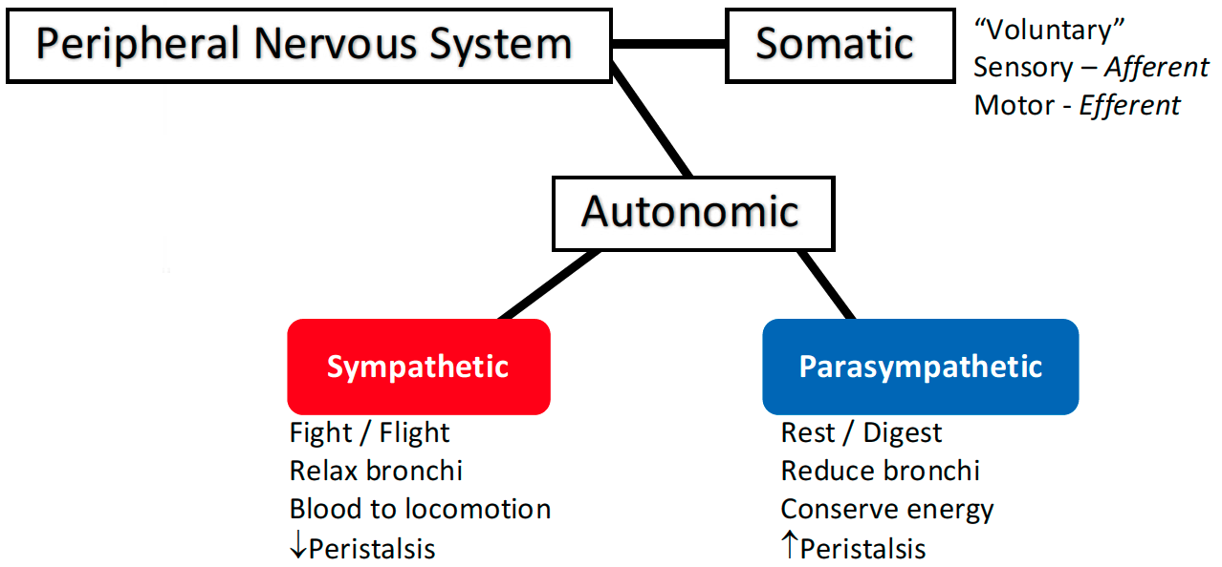
Extrinsic Factors – Cardiac Control Center
Control via :
Medulla :
Autonomic Nervous System
Vagus Nerve :
Parasympathetic
Primary controller of resting heart rate
Innervates SA node , AV node , atrial myocardium
Has an inhibitory influence on the heart
Decreases heart rate
Negative chronotropic effect

Slide 69
Extrinsic Factors – Cardiac Control Center
Control via :
Cardiac Nerve
Autonomic Nervous System
Sympathetic
Primary controller of heart contractility
Contributes very little to resting heart rate
Can cause large changes in heart rate contractility
Innervates SA node , AV node , atrial and ventricular myocardium
Has an excitatory influence on the heart
Increases heart rate
Positive chronotropic effect
Increases heat contractility
Positive ionotropic effect

Slide 70
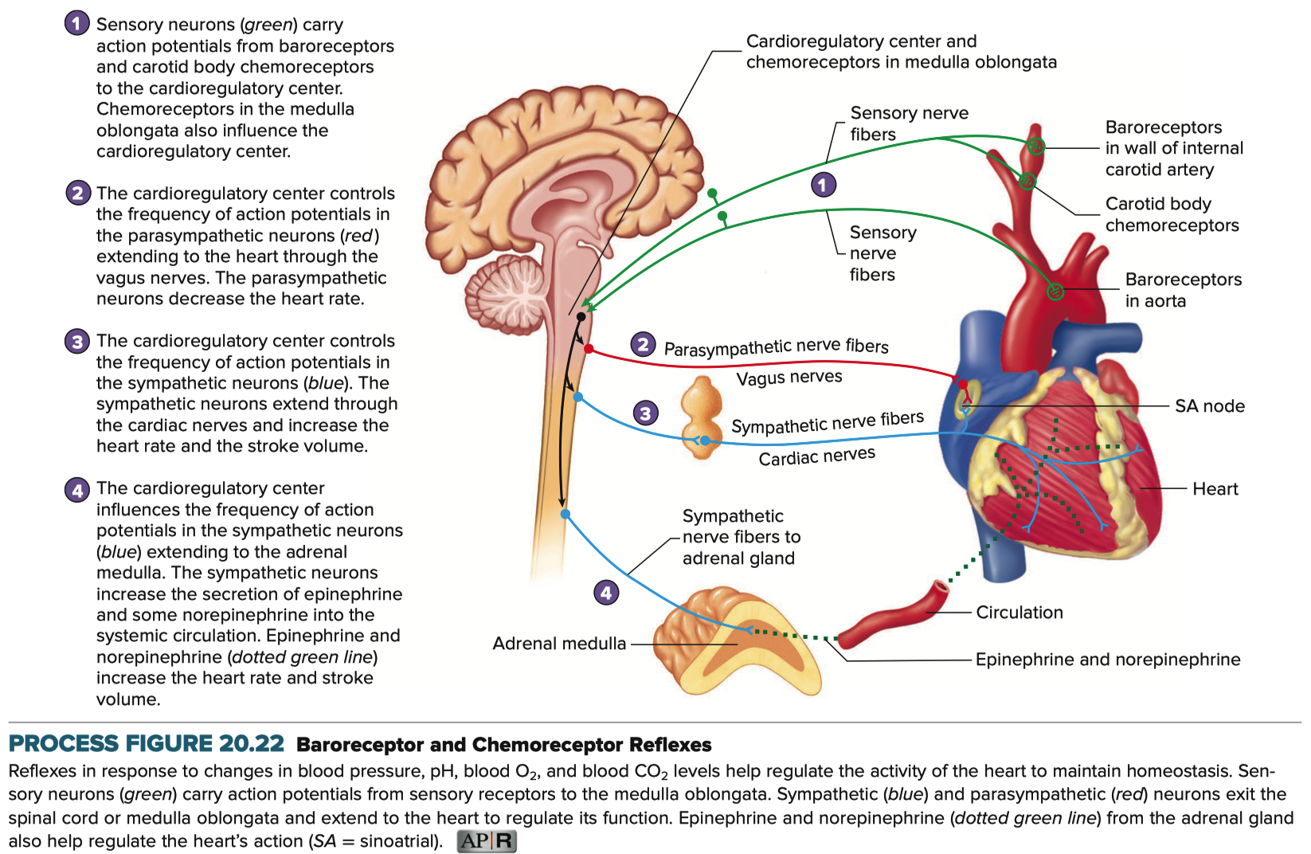

Slide 71
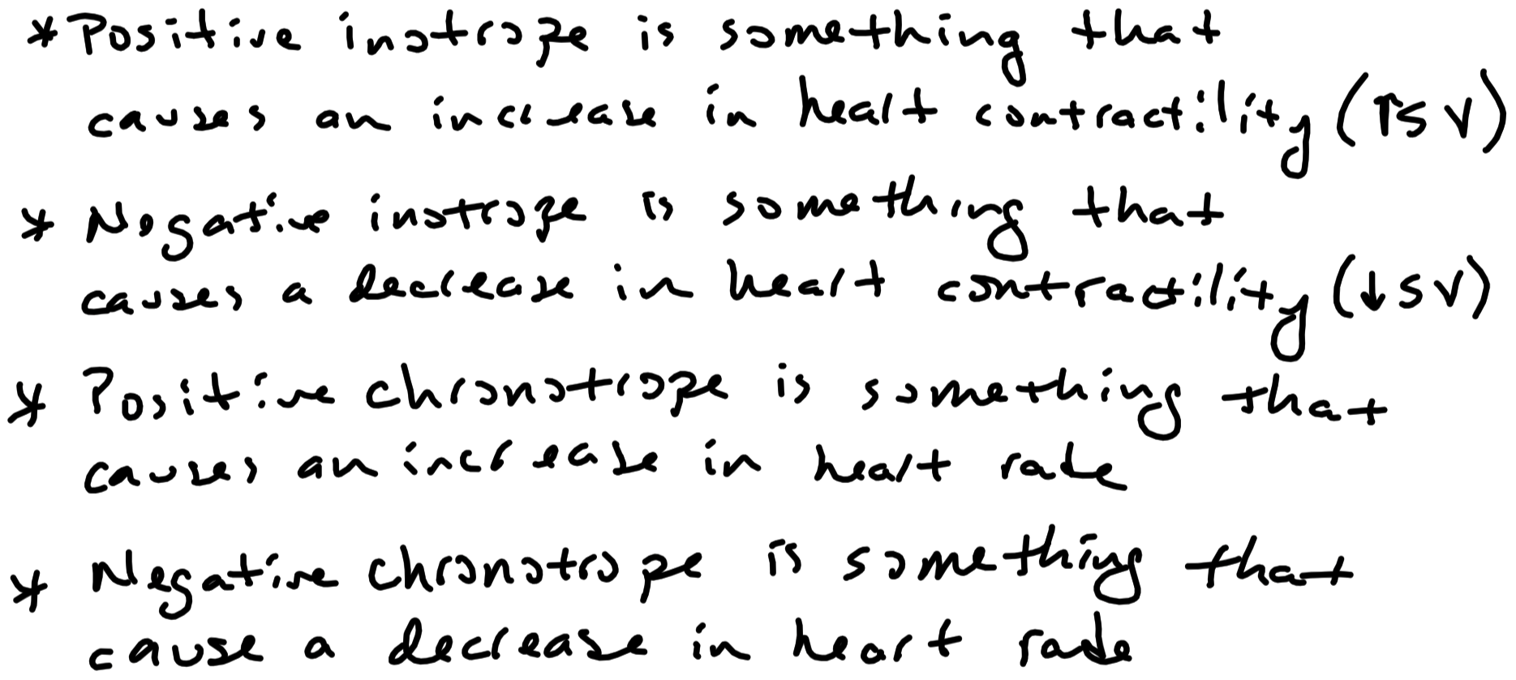

Slide 72
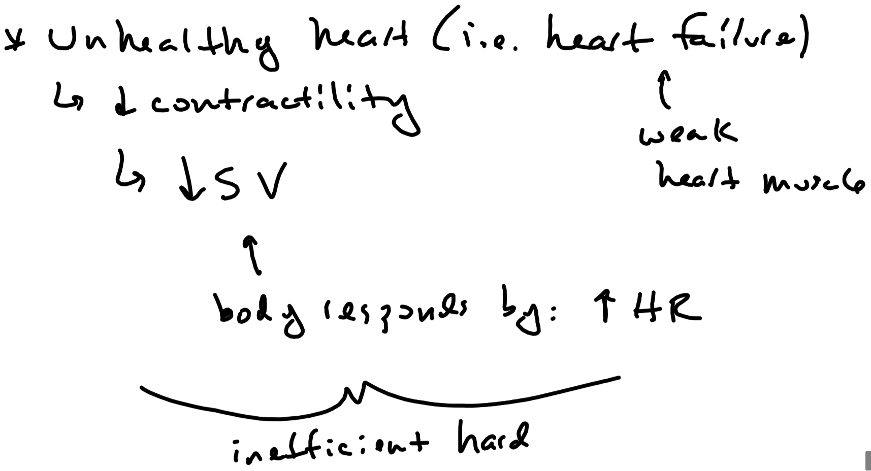

Slide 73
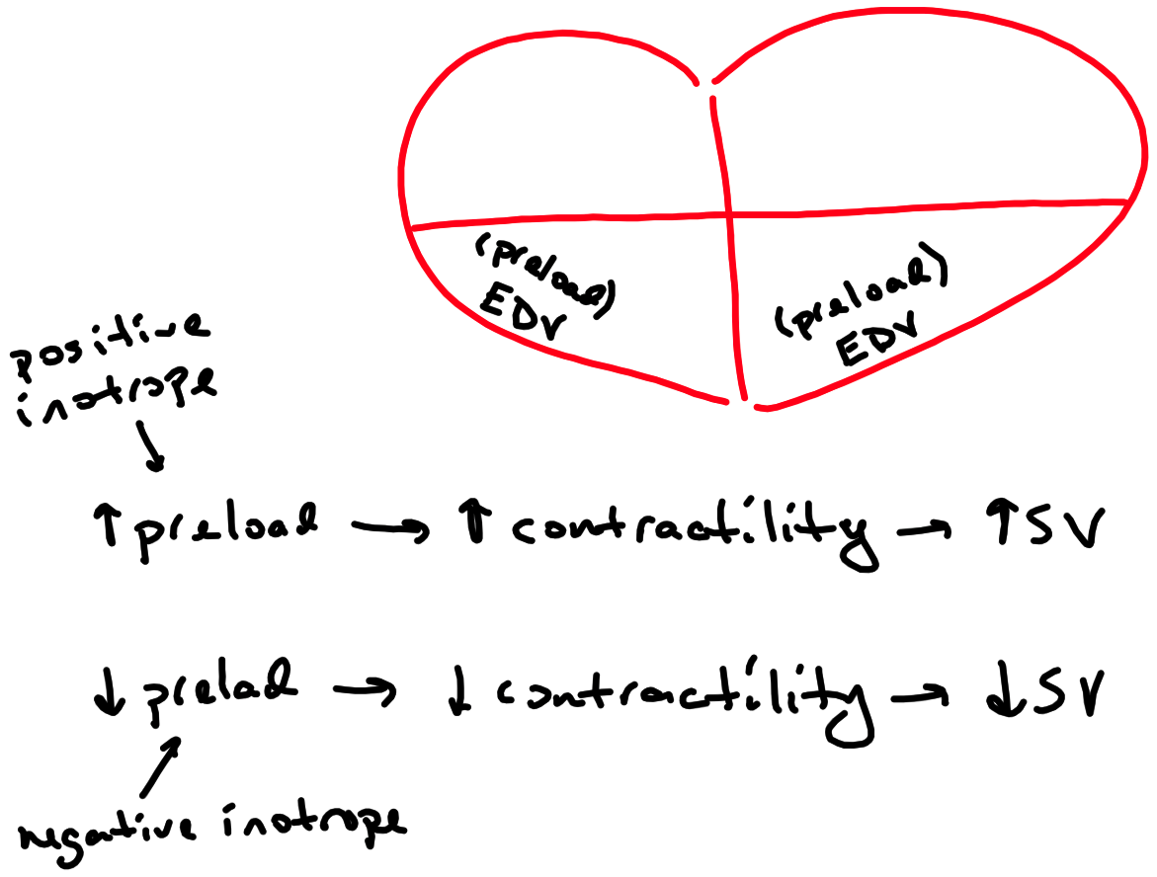

Slide 74
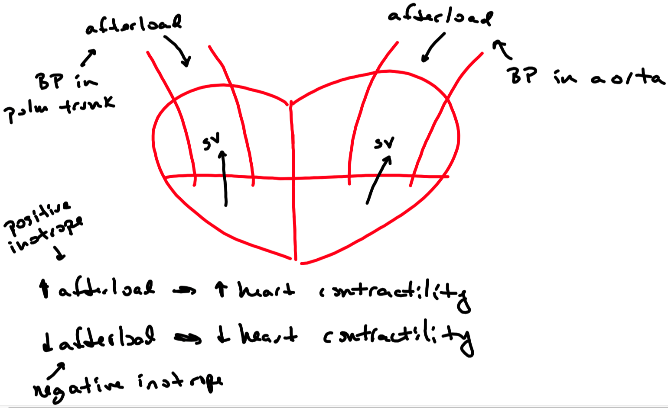

Slide 75
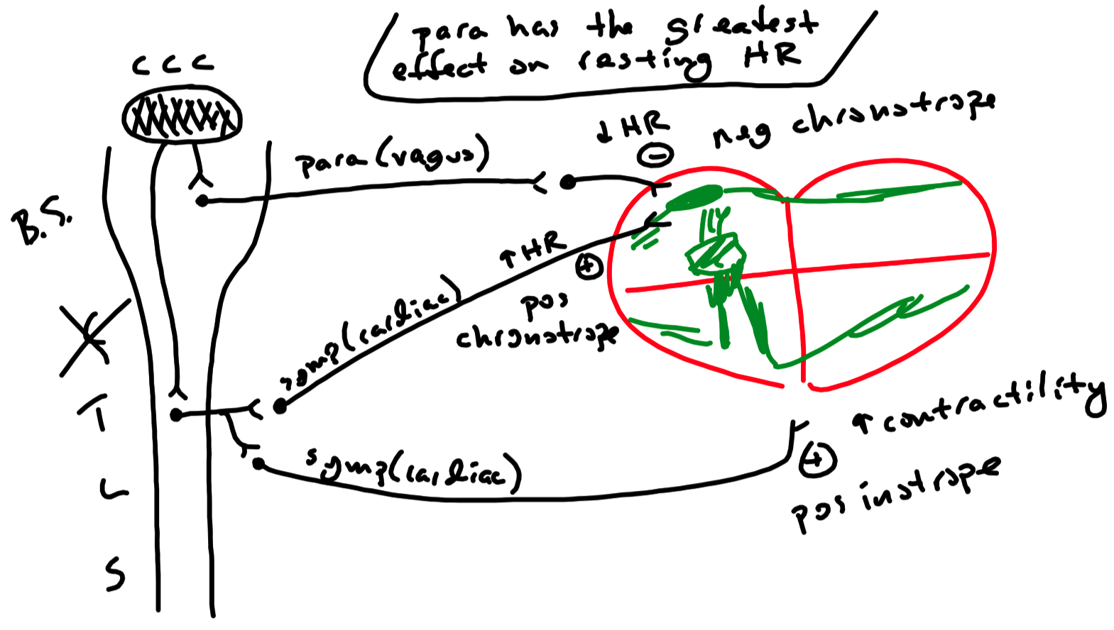

Slide 76
Extrinsic Factors – Hormones
Epinephrine and norepinephrine released from adrenal gland
Increases heart rate
Positive chronotropic effect
Increases heart contractility
Positive inotropic effect
Thyroid hormones ( T₃ and T₄ ) released from thyroid
Increase heart rate
Positive chronotropic effect
Increase heart contractility
Positive inotropic effect

Slide 77
Extrinsic Factors – Body Temperature
A change of 1°C changes heart rate approximately 10 beats per minute
Affects action potential generation and conduction
Increase temperature
Increase heart rate
Positive chronotropic effect
Decrease temperature
Decrease heart rate
Negative chronotropic effect

Slide 78
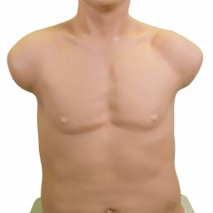
A
B
C
D

Slide 79
Blood Vessels
Arteries
Strong , thick , muscular elastic vessels
Adapted to carry blood under high pressure
Highest normal pressure is approximately 110 mm Hg
Contain approximately 10% of total blood volume
Function to distribute blood to the body
Carry oxygen , nutrients , hormones , enzymes , etc. to cells
Continually branch down to arterioles ( smallest branches of an artery )
Arterioles
Site of largest blood pressure drop
Contain approximately 5% of total blood volume
Contain large amounts of smooth muscle in their walls
Function to regulate blood pressure and blood flow to organs
Greatest resistance to blood flow
Blood flow and blood pressure influenced by sympathetic and local factors

Slide 80
Factors Contributing to Venous Return

Slide 81
Factors Contributing to Venous Return

Slide 82
Factors Contributing to Venous Return

Slide 83
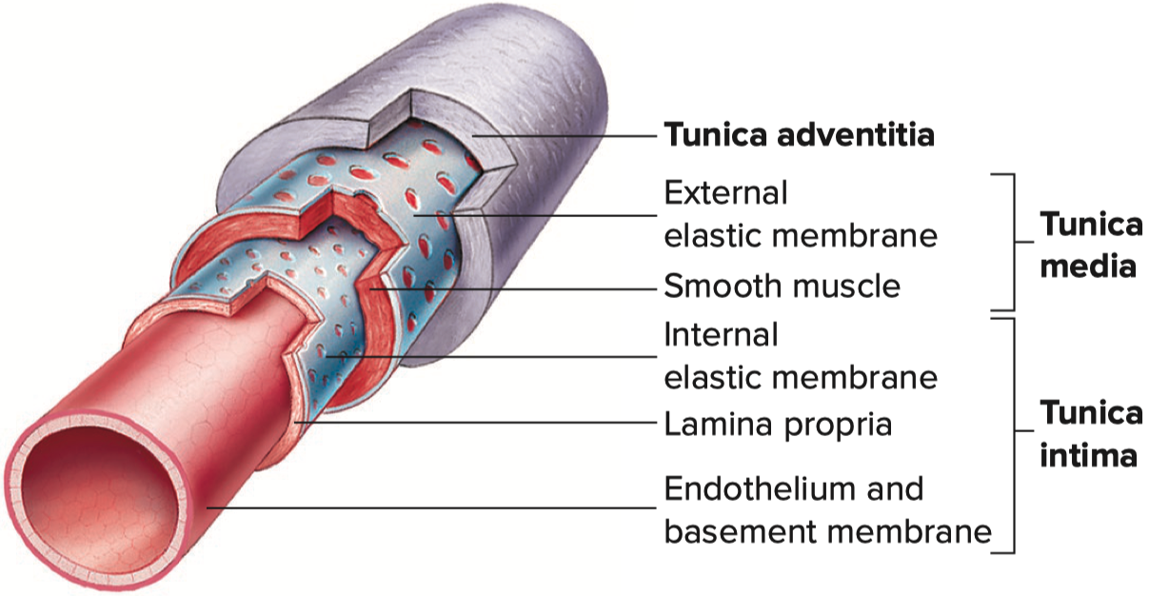
Veins and Venules

Slide 84
Blood Vessels
Capillaries
Smallest division of blood vessels
However , largest total cross sectional area
Contain approximately 5% of total blood volume
Form extensive networks close to every cell in the body
Function to deliver substances to cells and remove substances from cells
Very slow blood flow ( allows for full exchange of substances )
Walls are one cell thick ( optimizes diffusion )
Walls are somewhat permeable
Most have fenestrae – openings within endothelial cells
Allows substances to more easily
Diffuse and filter through

Slide 87
Permeability of Capillaries

Slide 88
Blood Flow
Two types of blood flow :
Laminar flow
Smooth blood flow occurring in parallel , concentric layers
Little resistance to blood flow
Turbulent flow
Rough , chaotic flow of blood
What can increase turbulence?
High velocity blood flow ( biggest influence )
Thinner ( lower viscosity ) blood
Branching of arteries
Increases resistance to blood flow ( harder for the heart to pump )
Can inflame and damage blood vessel walls
Can lead to thrombus formation and atherosclerosis
Atherosclerosis is hardening of arteries due to plaque formation

Slide 91
Poiseuille’s Law
Rate of blood flow in a blood vessel can be described by the following equation:
P₁ – P₂ P₁ = pressure at point one = upstream
Flow = ––––––– P₂ = pressure at point two = downstream
R R = resistance to flow
ν = viscosity of a fluid ( e.g. blood )
l = length of a tube ( e.g. blood vessel )
r = radius of a tube ( e.g. blood vessel )
Poiseuille’s Law
$$Resistance=\frac{8 ∗v ∗l}{π∗r^{4}}$$
$$Flow=\frac{\left( P_{1}−P_{2} \right)∗π∗r^{4}}{8 ∗v ∗l}$$

Slide 92
Poiseuille’s Law
Blood pressure gradient
Blood pressure falls progressively as blood :
leaves the heart
flows through systemic and pulmonary circulations
then back to the heart
If blood pressure is too low , blood pressure gradient is too low
Blood flow to organs is impaired
Organ failure and death can occur
Radius
Greatest effect on resistance to blood flow
Arterial radius affected by sympathetic tone and local factors
Vasoconstriction = decrease blood vessel radius
Vasodilation = increase blood vessel radius

Slide 93
Blood Pressure Gradient from Aorta to Right Atrium

Slide 94
Effect of Radius on Blood Flow
decrease radius ➡️ increase resistance
increase radius ➡️ decrease resistance
decrease blood flow tremendously
increase blood flow tremendously

Slide 99
Poiseuille’s Law
Viscosity
Measure of the “thickness” of a fluid
Increase viscosity = increase resistance = decrease in blood flow
Factors that increase viscosity
Increase in hematocrit
Greatest influence on blood viscosity
Dehydration ( concentrates substances in the blood )
High cholesterol and / or triglyceride levels
Stasis
Causes cell to cell and solute to cell adhesive interaction

Slide 101
Control of Blood Flow
Controlled via :
smooth muscle tone
Vasomotor Centers
Local Factors

Slide 102
Vasomotor Centers of the Brainstem
Vasomotor centers in the brainstem
Output via the sympathetics ( innervate vascular smooth muscle )
Stimulation of sympathetics
Vasoconstriction of skin and visceral blood vessels
Decreases blood flow to skin and viscera
Vasodilation of skeletal muscle blood vessels
Increases blood flow to skeletal muscle
Inhibition of sympathetics
Vasodilation of skin and visceral blood vessels
Increases blood flow to skin and viscera

Slide 103
Vasomotor Centers of the Brainstem

Slide 105
Sympathetic Innervation of Vascular Smooth Muscle

Slide 106
Effect of Radius on Blood Flow
vasoconstriction
vasodilation

Slide 110
Local Factors
Cause : smooth muscle relaxation ( vasodilation ) → increase blood flow
Nitric oxide
Histamine ( part of inflammatory response and allergic reactions ) ( Basophil )
Decrease in pH
Increase in CO₂
Decrease in O₂
Cause : smooth muscle contraction ( vasoconstriction ) → decrease blood flow
Thromboxane
Antidiuretic hormone / Vasopressin
Increase in pH
Decrease in CO₂
Increase in O₂

Slide 111
Blood Pressure
Measure of the force that blood exerts against blood vessel walls
Measure in millimeters of mercury ( mm Hg )
Systolic pressure: blood pressure during systole ( i.e. the “top” number )
Diastolic pressure: blood pressure during diastole ( i.e. the “bottom” number )
Pulse pressure: difference between systolic pressure and diastolic pressure

Slide 113
Mean Arterial Pressure ( MAP )
Average blood pressure in the arterial circulation
Normal range: 70 to 100 mmHg ( although as low as 60 mmHg is ok )
Weighted average: heart spends ⅓ of time in systole and ⅔ of time in diastole
Calculation:
MAP = ⅓ ( systolic pressure ) + ⅔ ( diastolic pressure )
OR
( systolic pressure ) + 2 ( diastolic pressure )
MAP = –––––––––––––––––––––––––––––––––––
3

Slide 114
Mean Arterial Pressure ( MAP )
Using a blood pressure of 110 mmHg / 70 mmHg as an example:
= ⅓ ( 110 mm Hg ) + ⅔ ( 70 mm Hg )
≈ 37 mm Hg + 47 mm Hg
≈ 84 mm Hg
OR
110 mm Hg + 2 ( 70 mm Hg )
= –––––––––––––––––––––––––
3
250 mm Hg
= –––––––––––
3
≈ 84 mm Hg

Slide 116
Blood Pressure Gradient from Aorta to Right Atrium

Slide 117
Mean Arterial Pressure ( MAP )
Also calculated using the following equation :
MAP = ( Cardiac Output ) x ( Total Peripheral Resistance )
Cardiac Output: product of stroke volume and heart rate
Total Peripheral Resistance: opposing force to blood flow
Factors affecting Total Peripheral Resistance ( TPR ) :
Arterial radius
Decrease radius = increase TPR
Increase radius = decrease TPR
Viscosity
Increase viscosity = increase TPR
Decrease viscosity = decrease TPR
Friction
Increase friction = increase TPR
Decrease friction = decrease TPR

Slide 118
Mean Arterial Pressure ( MAP )
What increases BP What decreases BP
Increase CO Decrease CO
Increase SV Decrease SV
Increase HR Decrease HR
Increase TPR Decrease TPR
Decrease radius Increase radius
Increase viscosity Decrease viscosity
Increase friction Decrease friction

Slide 119
Regulation of Blood Pressure
Baroreceptor Reflex
Renin-Angiotensin-Aldosterone System
Atrial Natriuretic Hormone
Antidiuretic Hormone ( ADH ) / vAsoPREssiN
Epinephrine and Norepinephrine

Slide 120
Regulation of Blood Pressure – Baroreceptor Reflex
Most important short-term ( second to second ) regulatory mechanism
Baroreceptors monitor blood pressure
Influence vasomotor center and cardiac control center
With an increase in blood pressure :
Baroreceptors stimulated ⟵ proportional to the change in BP
Causes an increase in action potential frequency
Interpreted by vasomotor / cardiac control centers
Stimulates parasympathetics
Decreases Heart Rate
Inhibits sympathetics
Decreases heart rate
Decreases heart contractility
Vasodilation to skin and viscera
With a decrease in blood pressure :
Baroreceptors inhibited ⟵ proportional to the change in BP
Causes a decrease in action potential frequency
Interpreted by vasomotor / cardiac control centers
Inhibits parasympathetics to increase BP
Increases heart rate
Stimulates sympathetics to increase BP
Increases heart rate
Increases heart contractility
Vasoconstriction to skin and viscera

Slide 123
Regulation of Blood Pressure – Renin-Angiotensin-Aldosterone System
Most important long-term regulatory mechanism
Angiotensinogen converted to angiotensin I via renin
Angiotensin I converted to angiotensin II
Conversion via angiotensin converting enzyme ( ACE )
Effects of angiotensin II
Vasoconstriction to skin and viscera
Increases blood pressure
Increases aldosterone release from the adrenal gland
Increases blood volume and thus blood pressure
Increases antiduretic hormone secretion by the pituitary gland
With an increase in blood pressure
Decrease angiotensin II production / decrease aldosterone release
Decreases blood pressure towards normal
With a decrease in blood pressure
Increase angiotensin II production / increase aldosterone release
Increases blood pressure towards normal

Slide 126
Regulation of Blood Pressure – Natriuretic Factor / Peptide / Hormone
Released by atria of the heart in response to high blood pressure
Stimulates the kidneys to transport sodium out of the blood
Water follows sodium osmotically
Decreases blood volume ➡️ blood pressure towards normal

Slide 127
Emergency Situations – When Blood Pressure is Too Low ( ie , Hypotension )
Antidiuretic hormone ( ADH ) / Vasopressin
Increases blood pressure via:
Increased blood volume
Vasoconstriction
Epinephrine and norepinephrine
Increases blood pressure via:
Increased heart rate
Increased heart contractility and thus increased stroke volume
Vasoconstriction

Slide 128
Factors That Affect Blood Pressure - Compliance
Measurement of the stretchiness/stiffness of a structure
Arterial wall distends ( stretches ) during systole
Dissipates the increased pressure during systole
Arterial wall recoils ( “snaps back” ) during diastole
Increases pressure during diastole to help maintain blood flow
Decrease in arterial compliance indicates the arteries are more stiff
Causes an increase in systolic blood pressure
Causes a decrease in diastolic blood pressure
Seen with arteriosclerosis: “hardening” of the arteries
Stretch of arterial wall during systole allows for measurement of a pulse
Measured at surface arteries ( e.g. radial and carotid )
Measurement of a pulse gives the heart rate

Slide 131
Arterial Compliance and Pulse

Slide 133
Hypotension
Abnormally low blood pressure
Dangerous ( and life threatening ) for two main reasons :
Blood pressure gradient is decreased
Critical closing pressure is reached

Slide 134
Hypotension
Blood pressure gradient for blood flow is decreased :
Blood flow to tissues is decreased
Tissues can die with decreased blood flow
Organ failure and death is possible
Critical closing pressure is reached :
Blood pressure at which blood vessels collapse
Causes ischemia: no blood flow to tissues
Tissue dies without blood flow
Organ failure and death is possible
Laplace’s Law
Force that prevents blood vessel collapse
Is equal to the product of blood pressure and diameter of the blood vessel
Force = P x D
P: blood pressure
D: diameter of blood vessel
In other words: blood pressure must be high enough to prevent the collapse of blood vessels

Slide 135
Circulatory Shock
Severe decrease in blood pressure , which leads to inadequate blood flow
Large decrease in blood pressure gradient
Critical closing pressure reached
Types of circulatory shock :
Hypovolemic shock – loss of blood volume decreases blood pressure
Vasodilatory shock – vasodilation decreases blood pressure
Cardiogenic shock – inadequate cardiac output decreases blood pressure

Slide 136
Reasons for Circulatory Shock
Hemorrhagic shock ( hypovolemic )
Bleeding that causes loss of blood volume
Anaphylactic shock ( vasodilatory )
Severe allergic response that causes massive release of inflammatory chemicals
Cause severe vasodilation
Septic shock ( hypovolemic , vasodilatory , and cardiogenic )
Develops from sepsis ( inflammatory response to infection )
Bleeding caused by leaky capillaries
Vasodilation
Decreases heart rate and contractility
Emotional shock ( vasodilatory and cardiogenic )
Sudden emotional trauma
Causes strong parasympathetic stimulation
Decreases heart rate
Causes strong sympathetic inhibition
Vasodilation
Decreases heart rate and contractility
Neurogenic shock ( vasodilatory and cardiogenic )
Causes strong inhibition of the sympathetics
Vasodilation
Decreases heart rate and contractility

Slide 137
Response of the Body to Hypotension
Increase heart rate and contractility ( if the heart is not the cause )
Attempts to increase cardiac output
Increases blood pressure
Vasoconstriction ( if the blood vessels are not the cause )
Attempts to increase total peripheral resistance
Increases blood pressure

Slide 138
Treatments for Hypotension
IV fluids and/or blood transfusion to increase blood volume
Administration of pressors to increase blood pressure
Epinephrine ( most powerful )
β-agonist
Increases contractility ( i.e. SV ) and heart rate
α-agonist
Vasoconstriction
Dopamine
β-agonist ( at medium doses )
Increases contractility ( i.e. SV ) and heart rate
β-agonist and α-agonist ( at high doses )
Increases contractility ( i.e. SV ) and heart rate
Vasoconstriction
Phenylephrine ( neo synephrine )
α-agonist
Vasoconstriction
Vasopressin
Increases blood volume
α-agonist
Vasoconstriction

Slide 139
Hypertension
Elevated ( borderline / pre-hypertension no longer exists as categories )
Systolic pressure from 120 to 129 mmHg
Diastolic pressure not taken into account
Stage 1 hypertension :
Systolic pressure from 130 to 139 mmHg
and / or
Diastolic pressure from 80 to 89 mmHg
Stage 2 hypertension :
Systolic pressure of 140 mmHg or above
and / or
Diastolic pressure of 90 mmHg or above
Hypertensive crisis :
Systolic pressure above 180 mmHg
and / or
Diastolic pressure above 120 mmHg
Essential / Primary hypertension :
Cause is unknown ( majority of cases )
Secondary hypertension :
Cause is known ( e.g. renal disease )

Slide 140
Complications Due to Hypertension
Heart failure
Heart must work harder to pump blood against a higher afterload
Inflammation of blood vessels
Can lead to thrombi
Can lead to atherosclerosis
Aneurysm
Blood vessels weaken and bulge from higher pressures
Rupture of aneurysm is life-threatening
Ruptured blood vessels from higher pressures
Can lead to organ dysfunction
Can lead to blindness

Slide 143
Treatments for Hypertension
Change of lifestyle to get into better shape and lose weight
e.g. 75% of overweight people that lose weight are cured
β-blockers
Decrease contractility ( i.e. SV ) and heart rate
α-blockers
Decrease peripheral resistance
Vasodilation
Calcium channel blockers
Inhibit calcium channels of conduction system and cardiac muscle
Decrease contractility ( i.e. SV ) and heart rate
Inhibit calcium channels of vascular smooth muscle
Decrease peripheral resistance
Vasodilation
Diuretics
Cause the excretion of fluids from the body
Decrease blood volume
ACE inhibitors
Inhibit production of angiotensin II
Decrease peripheral resistance
Vasodilation
Decrease blood volume ( via inhibition of aldosterone )
Angiotensin II receptor blockers
Decrease peripheral resistance
Vasodilation
Decrease blood volume ( via inhibition of aldosterone )
Renin inhibitors
Decrease peripheral resistance
Vasodilation
Decrease blood volume ( via inhibition of aldosterone )

Slide 144
A
B
A
B
C
C
D
D
E

Slide 145
Sinoatrial Node - Action Potential - Pacemaker
1.) Pacemaker Potential
.)
HCN
Sodium
Leak Channels are Open
.)
Sodium
Enters
∴ more positive , less negative
.)
Voltage-Gated
Potassium
Channels Close
.)
Less
Potassium
∴ more negative , less positive
.)
Voltage-Gated
Calcium
Channels Open
2.) Depolarization Phase
.)
Calcium
Enters
.)
Voltage-Gated
Potassium
Channels Close

Slide 146
Sinoatrial Node - Action Potential - Pacemaker
3.) Repolarization Phase
.)
Voltage-Gated
Calcium
Channels Close
.)
Voltage-Gated
Potassium
Channels Open
.)
Less
Potassium
∴ more negative , less positive

Slide 147
Cardiac Muscle - Action Potential
Threshold reached via:
Action potential from cardiac conduction system
Action potential from adjacent cardiac muscle cell
1.)
Voltage-Gated
Sodium
Channels Open
2.)
Sodium
Enters
3.)
Voltage-Gated
Potassium
Channels Open
4.)
Potassium
Leaves
5.)
Voltage-Gated
Calcium
Channels Open
6.)
Calcium
Enters
7.)
Voltage-Gated
Calcium
Channels Close
8.)
Potassium
Leaves

Slide 148
Cardiac Muscle - Action Potential
Threshold reached via:
Action potential from cardiac conduction system
Action potential from adjacent cardiac muscle cell
Phase 0
- fast depolarization phase
1.)
Voltage-Gated
Sodium
Channels Open
2.)
Sodium
Enters

Slide 149
Cardiac Muscle - Action Potential
Phase 1
- early fast repolarization
3.)
Voltage-Gated
Potassium
Channels Open
4.)
Potassium
Leaves

Slide 150
Cardiac Muscle - Action Potential
Phase 2
- Plateau Phase
5.)
Voltage-Gated
Calcium
Channels Open
Potassium is still leaving
6.)
Calcium
Enters
Called
Trigger Calcium

Slide 151
Cardiac Muscle - Action Potential
Phase 3
- Final Fast Repolarization Phase
7.)
Potassium
Leaves
8.)
Voltage-Gated
Calcium
Channels Close
Contraction stops when calcium is pumped back into the sarcoplasmic reticulum

Slide 152
Cardiac Muscle - Action Potential
Phase 4
- resting V_{m}
9.)
Potassium
Channels Eventually Close
10.)
Resting Vm is established

Slide 153
Isovolumetric contraction
Ejection
Isovolumetric Relaxation
Active Ventricular Filling
Ventricular Filling

Slide 154
First Heart Sound
Second Heart Sound
Third Heart Sound

Slide 155
First Heart Sound
Second Heart Sound
Third Heart Sound
Atrial Systole
Ventricular Systole
Ventricular Diastole

Slide 156
Semilunar Valves Close
Semilunar Valves Open
Dicrotic Notch
Diastolic Pressure
AV Valves Close
AV Valves Open

Slide 157
End of Diastolic Volume
End of Systolic Volume

Slide 158
ECG – Trace
PQ =
120
to
200
T =
160
to
200
P =
80
to
120
PQ =
120
to
200
QRS =
60
to
100
1 Box = 50 ms
1 Line = 250 ms

Slide 159
Sinoatrial node ( SA node )
“Pacemaker” of the heart
Spontaneously generates action potentials at a rate of about to to per minute
70
80

Slide 160
Ectopic Pacemaker
AV Node would slow heart rate to approximately to beats / min
40
60
Purkinje Fibers would slow heart rate to approximately to beats / min
25
45

Slide 161
Limb Leads – Standard Bipolar
Standard bipolar limb leads
Measure the electrical activity of the heart in a frontal plane
Lead I: right arm. ( – ) to left arm ( + )
Measures electrical activity across the heart at a 0° angle
Lead II: right arm ( – ) to left leg ( + )
Measures electrical activity across the heart at a +60° angle
Lead III: left arm ( – ) to left leg ( + )
Measures electrical activity across the heart at a +120° angle
Augmented unipolar limb leads
Measure the electrical activity of the heart in a frontal plane
aVR: right arm ( + ) to central terminal ground lead ( joining of left arm and left leg )
Measures electrical activity across the heart at a –150° angle
aVL: left arm ( + ) to central terminal ground lead ( joining of left leg and right arm )
Measures electrical activity across the heart at a –30° angle
aVF: left leg. ( + ) to central terminal ground lead ( joining of right arm and left arm )
Measures electrical activity across the heart at a +90° angle
Chest leads / Precordial leads
Measure the electrical activity of the heart in a transverse plane
V1 , V2 , V3 , V4 , V5 , V6 leads arranged across the chest
Right Arm
Left Arm
Right Arm
Left Leg
Left Arm
Left Leg
Right Arm
Left Arm
Left Leg

Slide 162
Limb Leads – Standard Bipolar
Standard bipolar limb leads
Measure the electrical activity of the heart in a frontal plane
Lead I. : right arm ( – ) to left arm ( + )
Measures electrical activity across the heart at a 0° angle
Lead II. : right arm ( – ) to left leg ( + )
Measures electrical activity across the heart at a +60° angle
Lead III. : left arm ( – ) to left leg ( + )
Measures electrical activity across the heart at a +120° angle
Augmented unipolar limb leads
Measure the electrical activity of the heart in a frontal plane
aVR: right arm ( + ) to central terminal ground lead ( joining of left arm and left leg )
Measures electrical activity across the heart at a –150 ° angle
aVL: left arm ( + ) to central terminal ground lead ( joining of left leg and right arm )
Measures electrical activity across the heart at a –30° angle
aVF: left leg ( + ) to central terminal ground lead ( joining of right arm and left arm )
Measures electrical activity across the heart at a +9° angle
Chest leads / Precordial leads
Measure the electrical activity of the heart in a transverse plane
V1 , V2 , V3 , V4 , V5 , V6 leads arranged across the chest
Lead 1
Lead 2
Lead 3
aVR
aVL
aVF

Slide 163
Limb Leads – Standard Bipolar
Standard bipolar limb leads
Measure the electrical activity of the heart in a frontal plane
Lead I: right arm ( – ) to left arm ( + )
Measures electrical activity across the heart at a 0 ° angle
Lead II: right arm ( – ) to left leg ( + )
Measures electrical activity across the heart at a +60. ° angle
Lead III: left arm ( – ) to left leg ( + )
Measures electrical activity across the heart at a +12. 0. ° angle
Augmented unipolar limb leads
Measure the electrical activity of the heart in a frontal plane
aVR: right arm ( + ) to central terminal ground lead ( joining of left arm and left leg )
Measures electrical activity across the heart at a –150. ° angle
aVL: left arm ( + ) to central terminal ground lead ( joining of left leg and right arm )
Measures electrical activity across the heart at a – ° angle
aVF: left leg ( + ) to central terminal ground lead ( joining of right arm and left arm )
Measures electrical activity across the heart at a +9. ° angle
Chest leads / Precordial leads
Measure the electrical activity of the heart in a transverse plane
V1 , V2 , V3 , V4 , V5 , V6 leads arranged across the chest
0
+60
+120
-150
-30
+90

Slide 164
Limb Leads – Standard Bipolar
Standard bipolar limb leads
Measure the electrical activity of the heart in a frontal plane
Lead I. : right arm. ( – ) to ( + )
Measures electrical activity across the heart at a ° angle
Lead II. : right arm ( – ) to left leg ( + )
Measures electrical activity across the heart at a ° angle
Lead III : left arm ( – ) to left leg ( + )
Measures electrical activity across the heart at a ° angle
Augmented unipolar limb leads
Measure the electrical activity of the heart in a frontal plane
aVR: : right arm ( + ) to central terminal ground lead ( joining of left arm and left leg )
Measures electrical activity across the heart at a ° angle
aVL. : left arm ( + ) to central terminal ground lead ( joining of left leg and right arm )
Measures electrical activity across the heart at a ° angle
aV. : left leg. ( + ) to central terminal ground lead ( joining of right arm and left arm )
Measures electrical activity across the heart at a ° angle
Chest leads / Precordial leads
Measure the electrical activity of the heart in a transverse plane
V1 , V2 , V3 , V4 , V5 , V6 leads arranged across the chest
Frontal Plane
Lead 1
Right Arm
Left Arm
0
Lead 2
Right Arm
Left Leg
+60
Lead 3
Left Arm
Left Leg
+120
Frontal Plane
aVR
Right Arm
-150
aVL
Left Arm
-30
aVF
Left Leg
+90
Transverse

Slide 165
Hypertension
Elevated ( borderline / pre-hypertension no longer exists as categories )
Systolic pressure from to 129. mmHg
Diastolic pressure not taken into account
Stage 1 hypertension :
Systolic pressure from to 129. mmHg
and / or
Diastolic pressure from to 129. mmHg
Stage 2 hypertension :
Systolic pressure from mmHg or above
Diastolic pressure of mmHg or above
Hypertensive crisis :
Systolic pressure above 180 mmHg
and / or
Diastolic pressure above 120 mmHg
Essential / Primary hypertension :
Cause is unknown ( majority of cases )
Secondary hypertension :
Cause is known ( e.g. renal disease )
120
129
130
139
80
89
140
90
140
120

